Slide 1
Modern Georgia: Societal and Technological growth
1945- Today

Slide 2
Georgia Post World War 2
AKS 40: Evaluate key post-World War II developments in Georgia
Explain how technology transformed agriculture and created a population shirt within the state.
Explain how the development of Atlanta under mayors William B. Hartsfield and Ivan Allen, Jr. impacted the state.
Generalize the impact of Ellis Arnall.
Describe the relationship between the end of the white primary and the 1946 governor's election

Slide 3
SS8H10a – Explain how technology transformed agriculture and created a population shift within the state
Population shift from rural to urban
Reasons for the shift in population before WW2
Destruction of cotton crop by the Boll Weevil
Great Migration of African Americans to the North
Movement of both blacks and whites to Georgia’s industrial centers and factories during both World Wars
AAA’s payments to farmers to stop them from growing crops
SS8H10- The student will evaluate key post-World War II developments in Georgia.

Slide 4
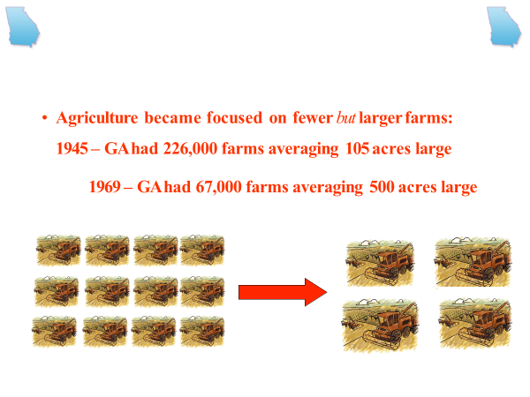
SS8H10a – Explain how technology transformed agriculture and created a population shift within the state
Population shift from rural to urban
Reasons for the shift in population after WW2
Major technological change in agricultural equipment lessened the need for large numbers of agricultural workers
Larger tractors
Reapers
Increase in machinery
Fertilizer
All this led to more crops being grown with less manpower
It’s important to know that although the rural population is less than 25% today faming still brings $56 billion a year to the state
SS8H10- The student will evaluate key post-World War II developments in Georgia.

Slide 5
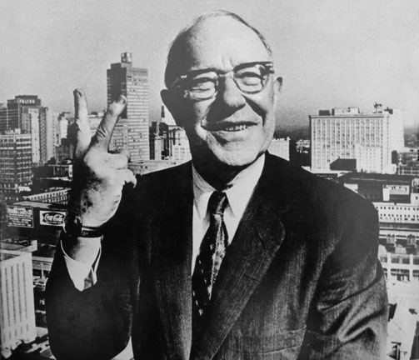
SS8H10b – Explain how the development of Atlanta under mayors William B. Hartsfield and Ivan Allen, Jr. impacted the state.
William B. Hartsfield
Longest serving mayor (1937- 1941; 1942- 1961)
Primarily known for two things
Bringing air transportation to the state
Coinage of the phrase “The city too busy to hate”
Supported Civil Rights movements that kept racial violence from Atlanta
He built a coalition of white businessmen and key African American leaders who worked to deal with racial issues and integration in peaceful ways.
SS8H10- The student will evaluate key post-World War II developments in Georgia.

Slide 6
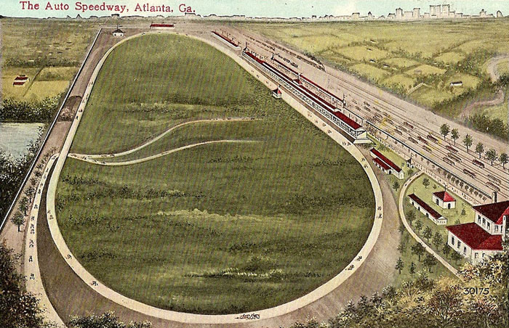
SS8H10b – Explain how the development of Atlanta under mayors William B. Hartsfield and Ivan Allen, Jr. impacted the state.
William B. Hartsfield
Airport
In the 1920s, he saw the potential for Atlanta as an aviation hub and played a major role in transforming an old speedway into Candler Field, the city’s first airport.
Eventually, the airport grew to be the busiest in the country and made Atlanta a major hub for US and international travel.
Hartsfield was nicknamed, “the Father of Atlanta Aviation”, and the city renamed the airport after him in 1971.
SS8H10- The student will evaluate key post-World War II developments in Georgia.

Slide 7
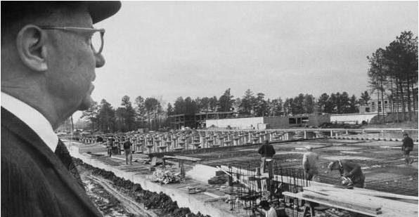

Slide 8
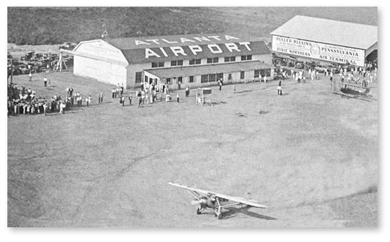
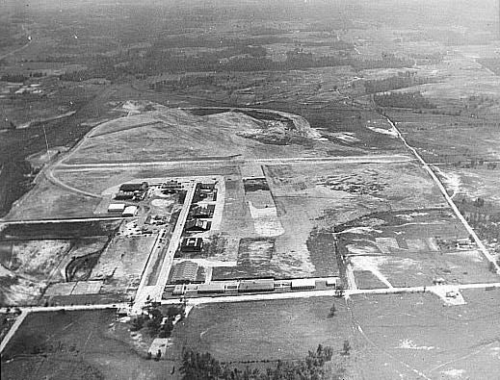
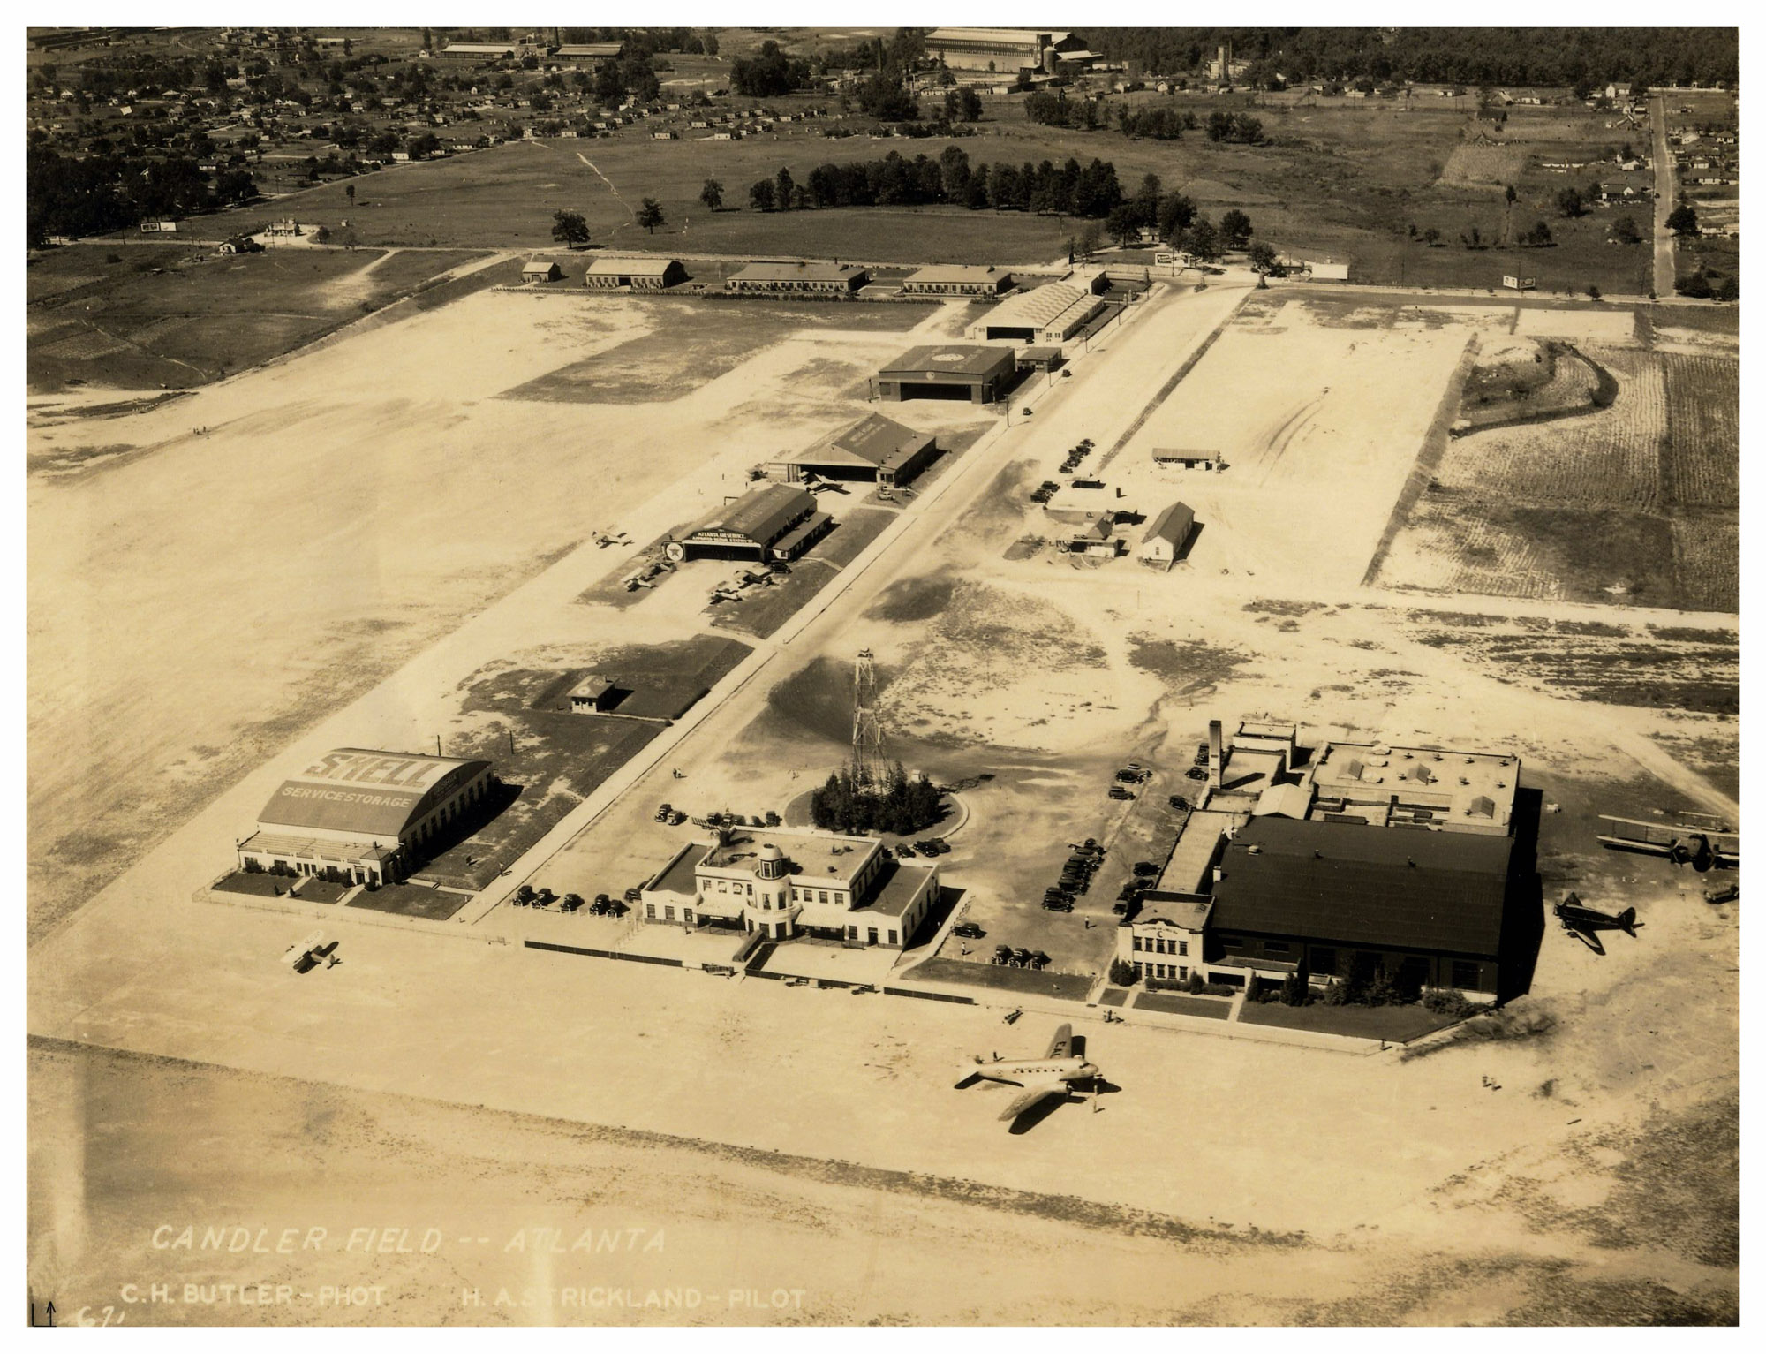

Slide 9
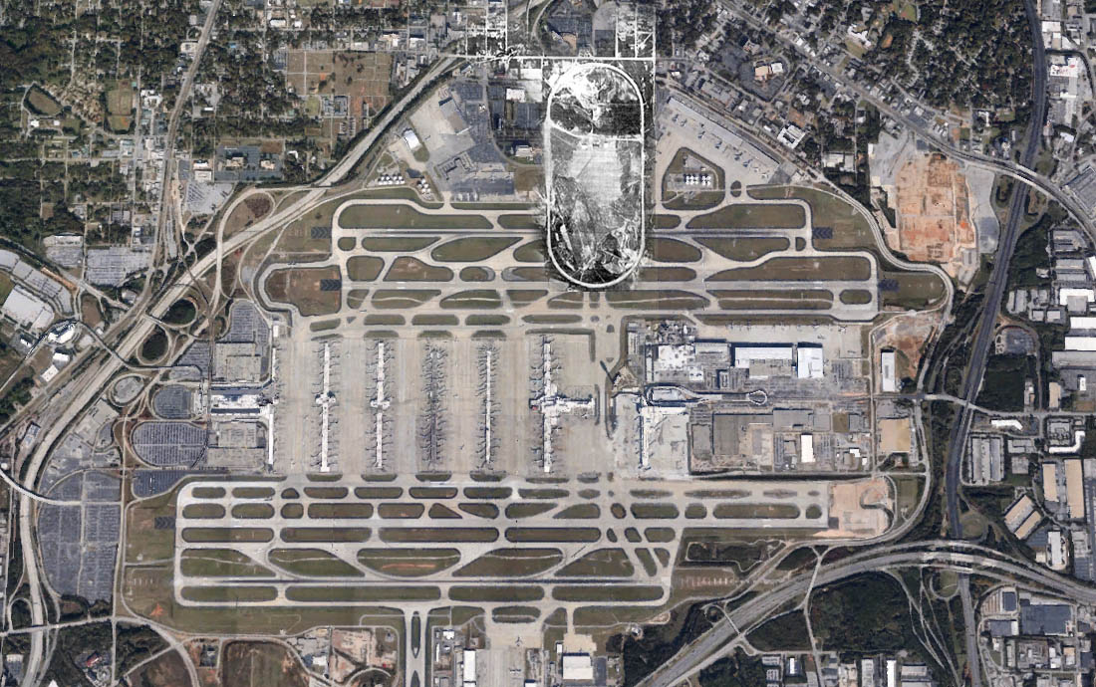

Slide 10
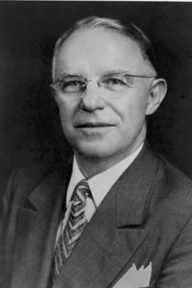
SS8H10b – Explain how the development of Atlanta under mayors William B. Hartsfield and Ivan Allen, Jr. impacted the state.
William B. Hartsfield
Other notable accomplishments
Helped integrate Atlanta Public city schools
Hired African American Police officers
Triple Atlanta’s size by incorporating surrounding areas
Building projects such as expressways and public parks
SS8H10- The student will evaluate key post-World War II developments in Georgia.

Slide 11
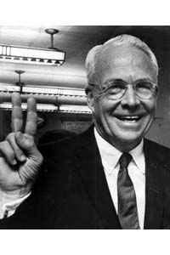
SS8H10b – Explain how the development of Atlanta under mayors William B. Hartsfield and Ivan Allen, Jr. impacted the state.
Ivan Allen Jr.
Progressive Atlanta mayor from 1962-1970
Succeeded William Hartsfield
Continued to fight for Civil Rights
On his first day as mayor he removed all the “Colored” and “White” signs from City Hall
Other notable achievements
Early advocate for MARTA
Instrumental in building I-285
Responsible for 55 new building projects
However Allen’s most significant contribution was professional sports teams to Atlanta
SS8H10- The student will evaluate key post-World War II developments in Georgia.

Slide 12
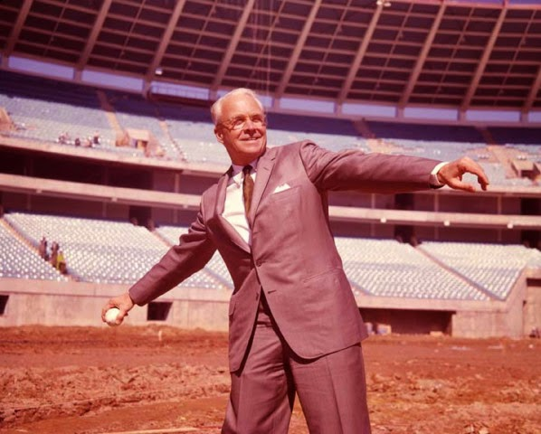
SS8H10b – Explain how the development of Atlanta under mayors William B. Hartsfield and Ivan Allen, Jr. impacted the state.
Ivan Allen Jr.
Atlanta Braves
Atlanta’s first major sports team
Came from Milwaukee and started playing in 1966
Famous player Henry ‘Hank’ Aaron broke Babe Ruth’s Homerun Record
Atlanta Falcons
Allen convinced the NFL to franchise a team in Atlanta and the Falcons played their first season in 1966.
Atlanta Hawks
Formerly the St. Louis Hawks, the Atlanta Hawks in 1968
SS8H10- The student will evaluate key post-World War II developments in Georgia.

Slide 13
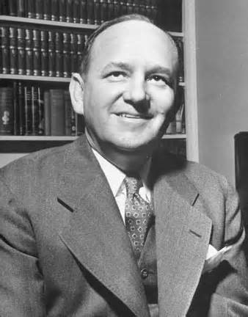
SS8H10c – Generalize the impact of Ellis Arnall.
Ellis Arnell
Served as governor from 1943- 1947
In a major surprise victory, he beat Eugene Talmadge for Governor in 1943
Considered one of the most open-minded and effective governors in Georgia history. Why?
Removed Governor from the University of Georgia’s Board of Trustees and restored UGA’s accreditation.
Lowered the voting age to 18
Abolished the poll tax in Georgia
Revised the State’s constitution
Paid off the state debt
Prison reform
Overall Ellis Arnell was known for his progressive stances
SS8H10- The student will evaluate key post-World War II developments in Georgia.

Slide 14
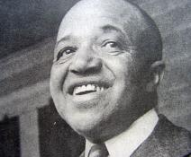
SS8H10d – Describe the relationship between the end of the white primary and the 1946 governor's election
End of The White Primary
Tactic used by Southern Whites to keep African Americans from voting in the Democratic primary
Since Georgia was a one party state at the time, the Democratic Primary was essentially the election and kept African Americans from voting
In 1944 several African Americans led by Dr. Thomas Brewer and Primus E. King attempted to vote in a white primary in Columbus, Ga.
King was told he could not vote and was forcibly removed from the court house
SS8H10- The student will evaluate key post-World War II developments in Georgia.

Slide 15
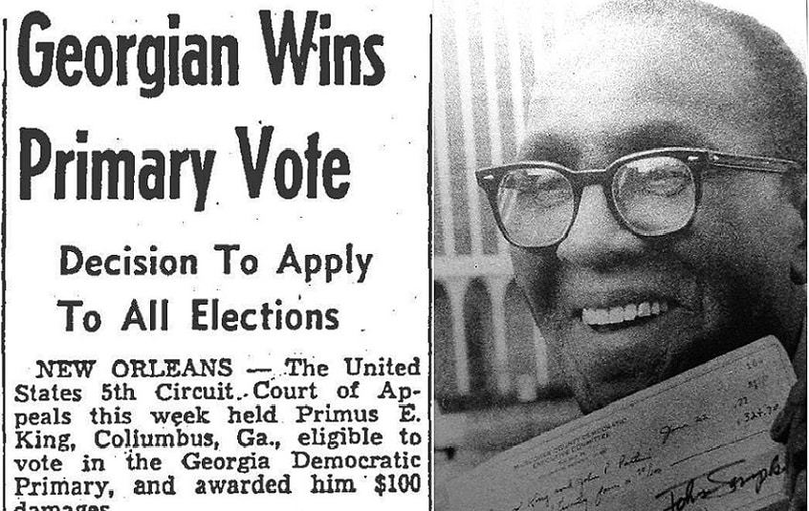
SS8H10d – Describe the relationship between the end of the white primary and the 1946 governor's election
End of The White Primary
In 1945 Brewer, King and several other African Americans sued the state
In the court case King v. Chapman et al., the federal district court ruled in favor of King and said the white primary was unconstitutional
Governor Ellis Arnall, did not fight the ruling and the white primary ended in Georgia.
SS8H10- The student will evaluate key post-World War II developments in Georgia.

Slide 16
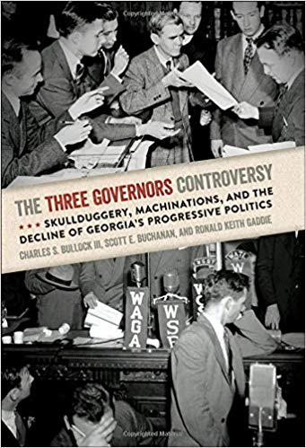
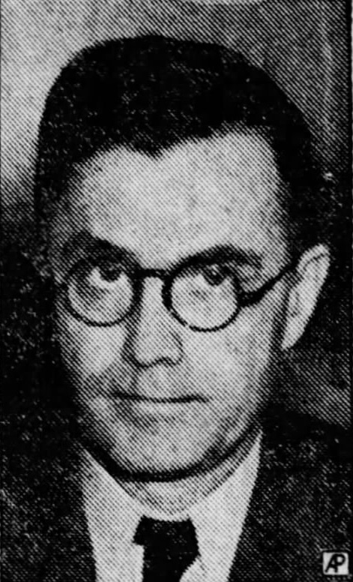
SS8H10d – Describe the relationship between the end of the white primary and the 1946 governor's election
The 1946 Election/ Three Governor’s Controversy
In 1946 Eugene Talmadge was elected for a fourth term as governor of Georgia. However he died before taking office
Because of Talmadge’s death three men claimed the governor’s office.
Herman Talmadge
Melvin Thompson
Ellis Arnell
SS8H10- The student will evaluate key post-World War II developments in Georgia.

Slide 17
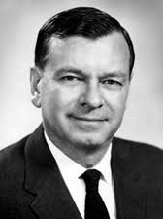
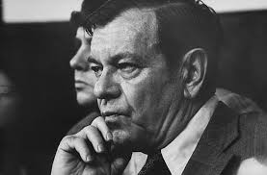
SS8H10d – Describe the relationship between the end of the white primary and the 1946 governor's election
The 1946 Election/ Three Governor’s Controversy
Herman Talmadge
Before the election of 1946 many of Eugene Talmadge’s supporters believed he would die before taking office. They found an outdated law that stated the Georgia General Assembly could select the second or third leading vote getter for governor if the governor- elect died before taking office. Because of this many secretly voted for Herman Talmadge as governor
SS8H10- The student will evaluate key post-World War II developments in Georgia.

Slide 18
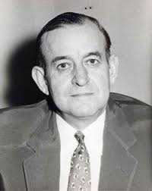
SS8H10d – Describe the relationship between the end of the white primary and the 1946 governor's election
The 1946 Election/ Three Governor’s Controversy
Melvin Thompson
Melvin Thompson was the lieutenant governor of Georgia underneath Eugene Talmadge. The new Georgia Constitution stated that the lieutenant governor would take office if the governor died
Because of this law Melvin Thompson argued he was rightful governor of Georgia
SS8H10- The student will evaluate key post-World War II developments in Georgia.

Slide 19
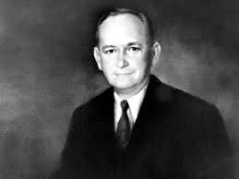
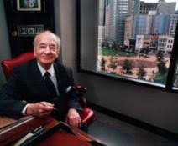
SS8H10d – Describe the relationship between the end of the white primary and the 1946 governor's election
The 1946 Election/ Three Governor’s Controversy
Ellis Arnell
Ellis Arnell was the outgoing governor but refused to leave office until the issue was resolved. He believed that the General Assembly did not have the authority to elect a governor
Eventually Talmadge had state troopers escort Arnall out of office and Arnall set us a second ‘governor’s office’ in the state capitol
SS8H10- The student will evaluate key post-World War II developments in Georgia.

Slide 20
SS8H10d – Describe the relationship between the end of the white primary and the 1946 governor's election
The 1946 Election/ Three Governor’s Controversy
Conclusion
Arnall finally gave up his claim and supported Thompson
In the end the Georgia Supreme Court ruled that Thompson was the rightful governor and Herman Talmadge left.
A special election was called in 1948 and Herman Talmadge closely defeated Thompson
This controversy made Georgia a nationwide laughingstock. More importantly it led tod to a series of segregationist governors who ended some of the progressive reforms made by Governor Ellis Arnall
SS8H10- The student will evaluate key post-World War II developments in Georgia.

Slide 21
Modern Georgia: Civil Rights

Slide 22
AKS 41: evaluate the role of Georgia in the modern civil rights movement
Explain the government of Georgia's response to Brown v. Board of Education including the 1956 flag and the Sibley Commission.
Describe the role of individuals (Martin Luther King Jr. and John Lewis), groups (SNCC and SCLC) and events (Albany Movement and March on Washington) in the Civil Rights Movement.
Explain the resistance to the 1964 Civil Rights Act, emphasizing the role of Lester Maddox.

Slide 23
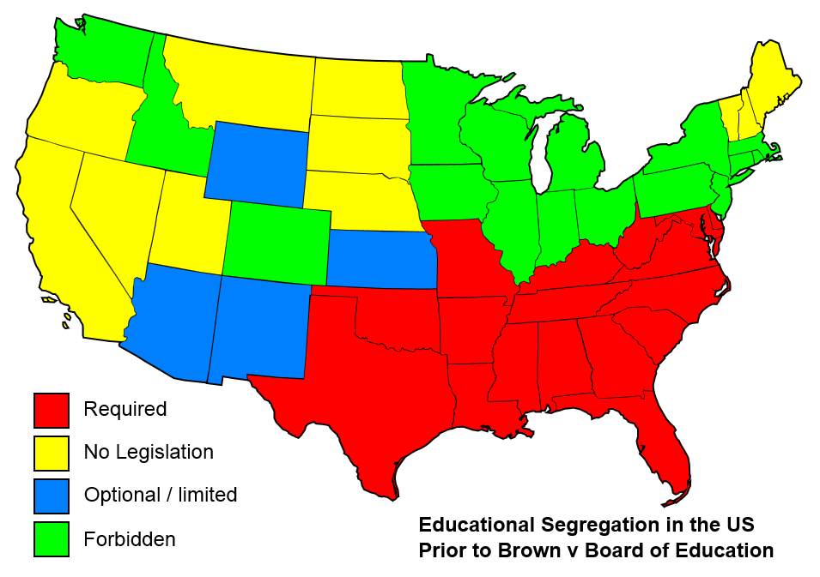

Slide 24
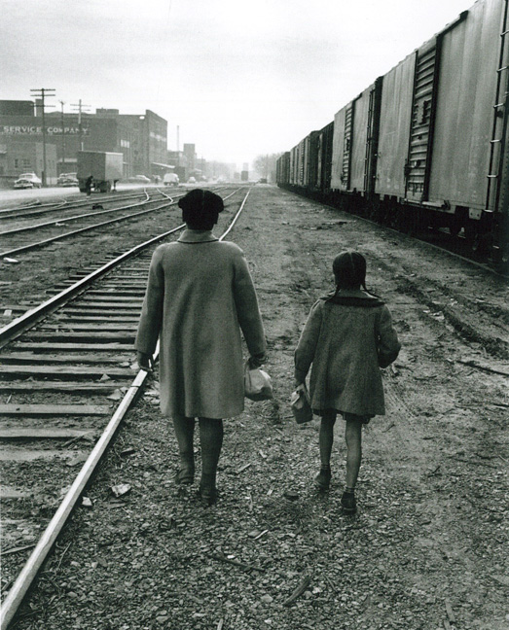
SS8H11a – Explain Georgia’s response to Brown v. Board of Education including the 1956 flag and the Sibley Commission.
Brown v. Board of Education
In 1954, Oliver Brown sued the board of education in Topeka, Kansas because the schools were segregated.
His third grade daughter, Linda, had to travel one mile to get to her black school, even though the white school was a lot closer.
In 1954, the Supreme Court handed down a unanimous decision that greatly impacted Georgia and the rest of the South.
In a 9-0 decision the court ruled that segregation was unconstitutional, and public schools across America began to integrate.
SS8H11- The student will evaluate the role of Georgia in the modern civil rights movement..

Slide 25
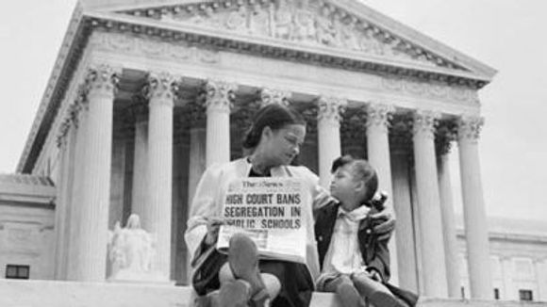
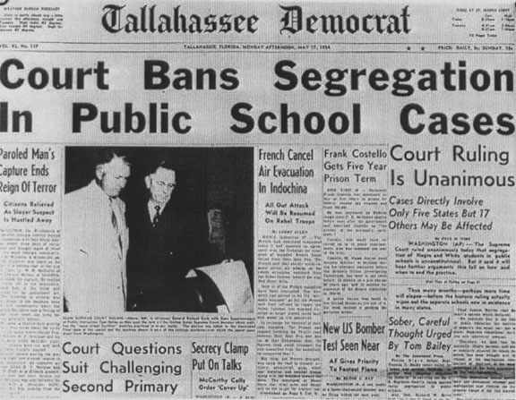

Slide 26
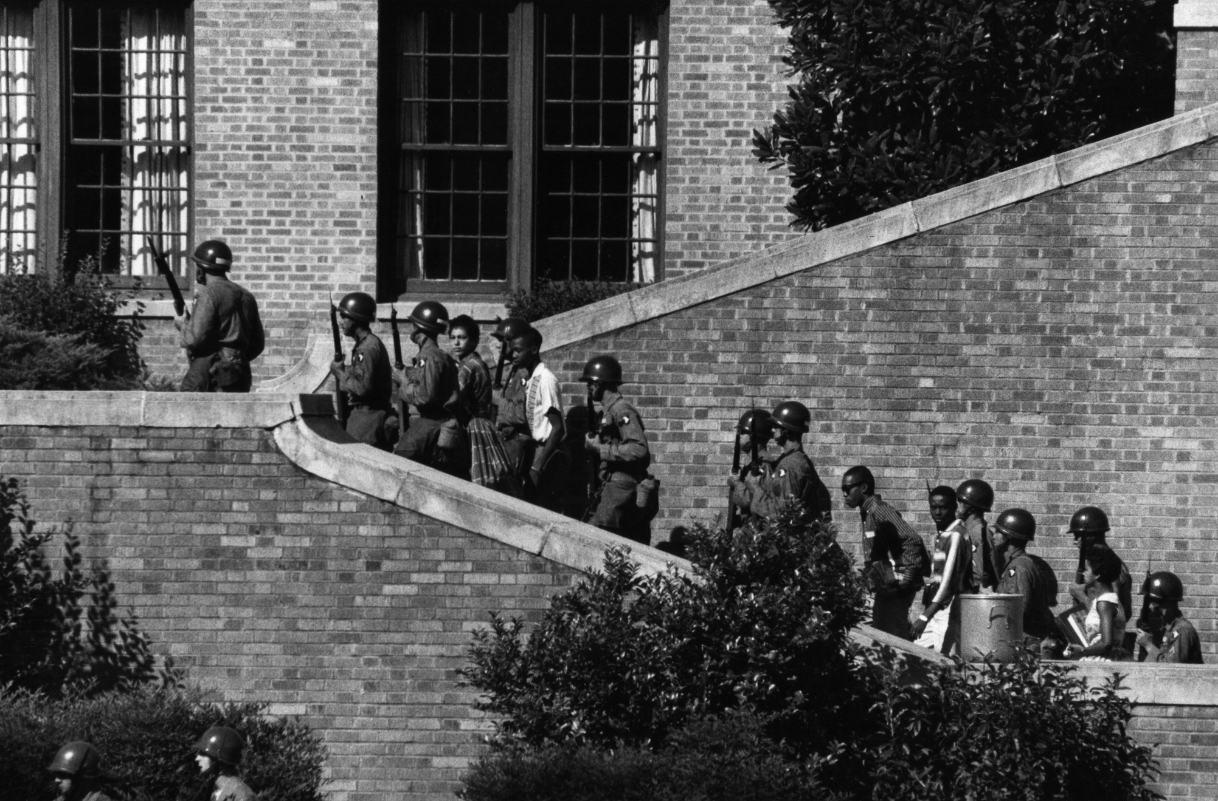
SS8H11a – Explain Georgia’s response to Brown v. Board of Education including the 1956 flag and the Sibley Commission.
Brown v. Board of Education
This case overturned the earlier 1896 Plessy v. Ferguson case that declared the “separate but equal” doctrine.
Even though all 9 of the justices ruled that any separation would not be equal, many southern states refused to segregate their schools.
Georgia’s governor, Herman Talmadge, strongly opposed the decision and encouraged Georgia’s legislature to rebel against the ruling.
SS8H11- The student will evaluate the role of Georgia in the modern civil rights movement..

Slide 27
SS8H11a – Explain Georgia’s response to Brown v. Board of Education including the 1956 flag and the Sibley Commission.
1956 State Flag
In 1956, the Georgia Assembly approved the state’s most controversial flag.
While legislators denied that the change in flag design was an overt display of opposition to desegregation, the new flag design was almost certainly racially motivated
The flag represented Georgia for 45 years until it was finally replaced in 2001.
SS8H11- The student will evaluate the role of Georgia in the modern civil rights movement..

Slide 28
1956- 2001
1920- 1956 2001-Today

Slide 29
SS8H11a – Explain Georgia’s response to Brown v. Board of Education including the 1956 flag and the Sibley Commission.
Sibley Commission
After schools were forced to desegregate by law in 1954, Georgia refused to cooperate.
Governor Ernest Vandiver asked the citizens of the state to render their input regarding the controversy via the Sibley Commission
John Sibley led ten hearings across the state to determine if the people felt that they should continue to resist the federal government or change laws to integrate
After the sessions, 60% of Georgians claimed that they would rather close the public schools than to integrate
SS8H11- The student will evaluate the role of Georgia in the modern civil rights movement..

Slide 30
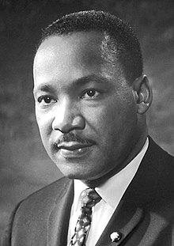
SS8H11b – Describe the role of individuals (Martin Luther King Jr. and John Lewis), groups (SNCC and SCLC) and events (Albany Movement and March on Washington) in the Civil Rights Movement.
Martin Luther King Jr. (1929- 1968)
Influential leader of the Civil Rights Movement, arguably the most well known Georgian.
Born in Atlanta, graduated high school at 15 and attended Morehouse College
Would later get his Ph.D. in Divinity from Boston University
Led several successful endeavors including the:
Montgomery Bus Boycott
March on Washington
Creation of the SCLC
His voter registration campaign in Selma, Alabama (which ultimately led to the Voting Rights Act of 1965)
Won the Nobel Peace Prize.
SS8H11- The student will evaluate the role of Georgia in the modern civil rights movement..

Slide 31
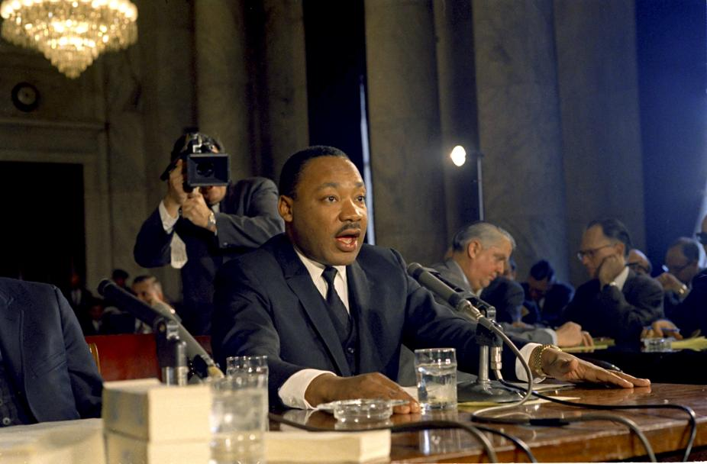
SS8H11b – Describe the role of individuals (Martin Luther King Jr. and John Lewis), groups (SNCC and SCLC) and events (Albany Movement and March on Washington) in the Civil Rights Movement.
Martin Luther King Jr. (1929- 1968)
The only African American to have a federal holiday named in his honor and the only African American non-president to have a memorial on the National Mall in D.C.
SS8H11- The student will evaluate the role of Georgia in the modern civil rights movement..

Slide 32
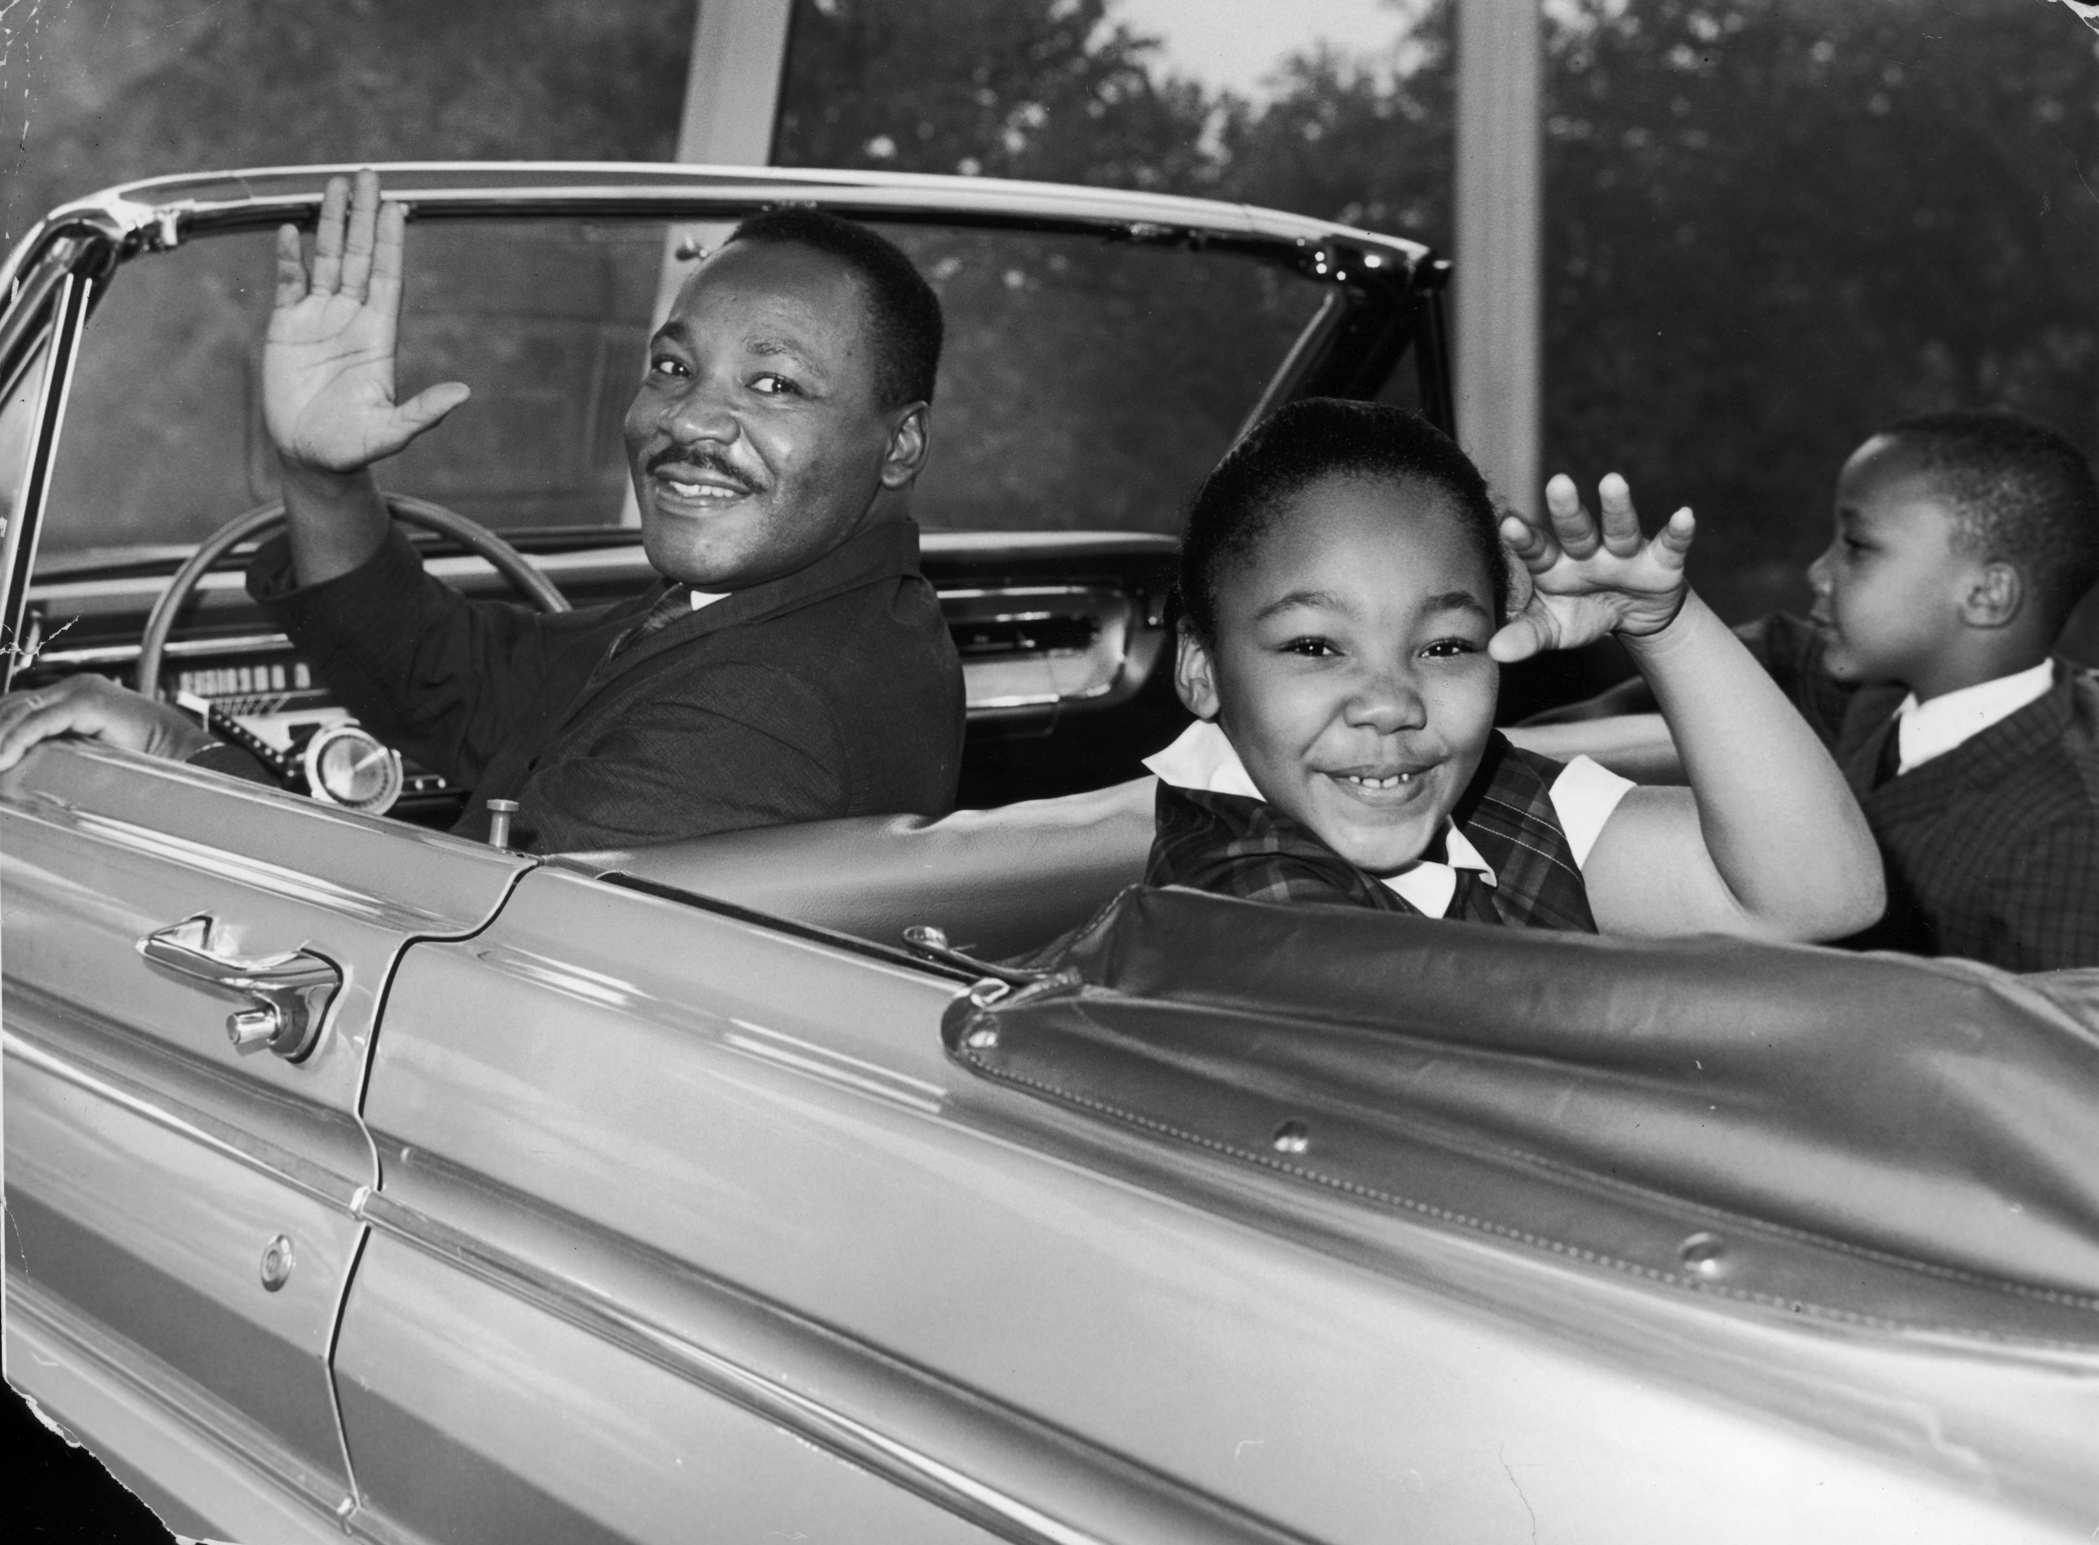
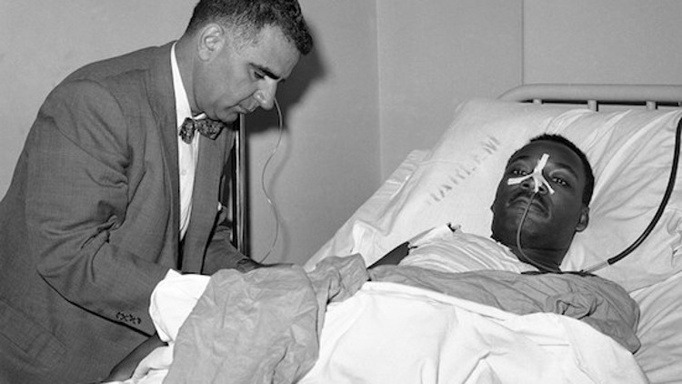
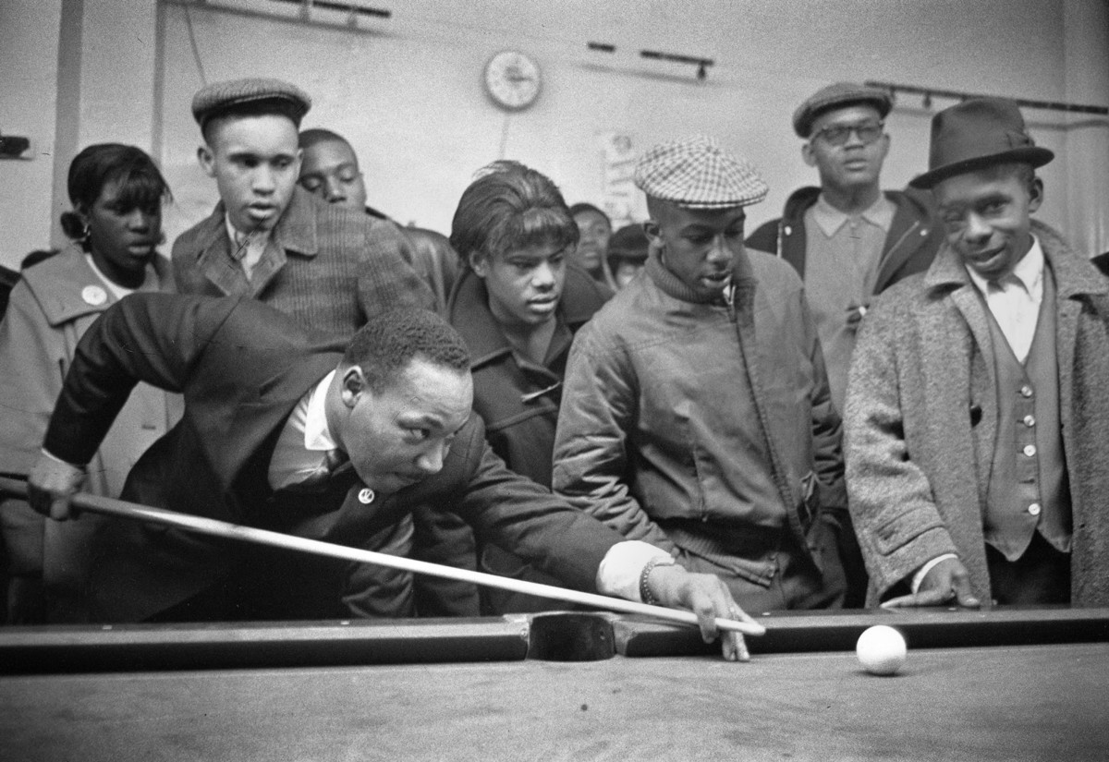
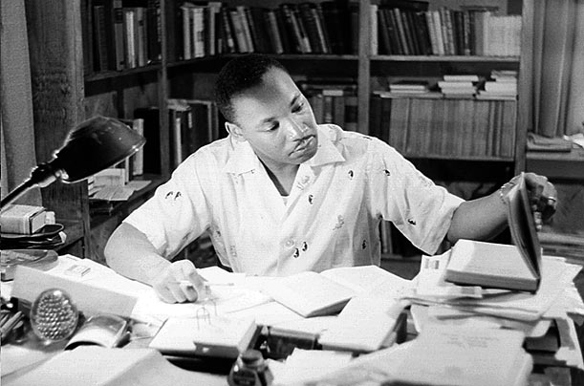

Slide 33
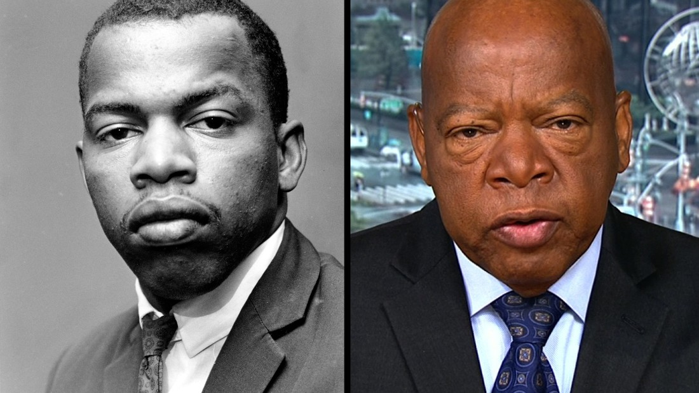
SS8H11b – Describe the role of individuals (Martin Luther King Jr. and John Lewis), groups (SNCC and SCLC) and events (Albany Movement and March on Washington) in the Civil Rights Movement.
John Lewis (1940- )
Born to sharecroppers in Pikes county, Alabama, Lewis became an integral part of the Civil Rights Movement.
John Lewis participated in several Civil rights events:
1960’s sit-ins
Freedom Rides of the early 1960’s
Became the chair of the SNCC
Keynote speaker at the 1963 March on Washington
Led over 600 marchers across the Edmund Pettus Bridge in Selma
SS8H11- The student will evaluate the role of Georgia in the modern civil rights movement..

Slide 34
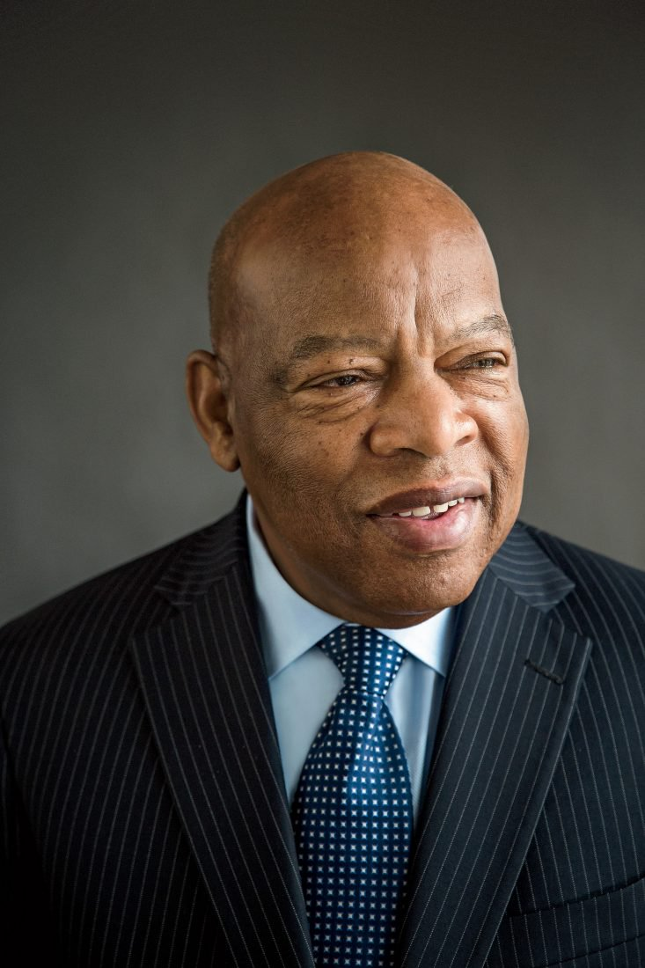
SS8H11b – Describe the role of individuals (Martin Luther King Jr. and John Lewis), groups (SNCC and SCLC) and events (Albany Movement and March on Washington) in the Civil Rights Movement.
John Lewis (1940- )
In the late 1960’s and 70’s, Lewis continued his dedication to seeking civil rights through voter registration and volunteer programs.
Eventually was elected to Atlanta City Council in 1981, and in November of 1986 was elected to Congress as the representative for the 5th district where he continues to serve today.
SS8H11- The student will evaluate the role of Georgia in the modern civil rights movement..

Slide 35
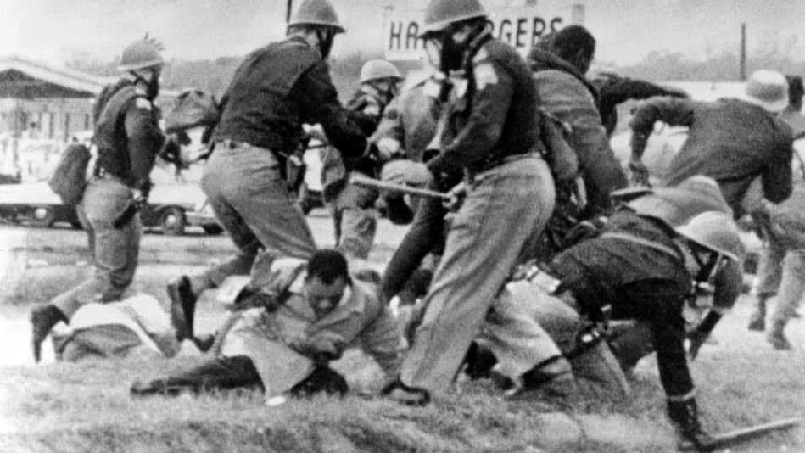
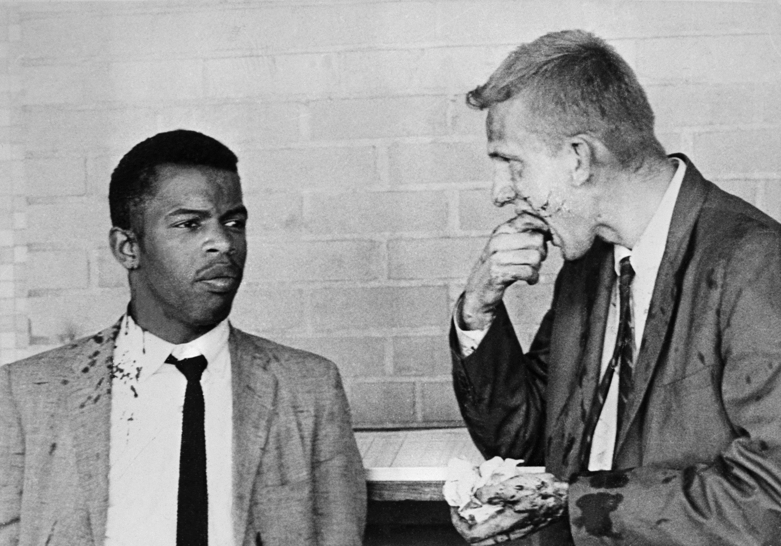

Slide 36
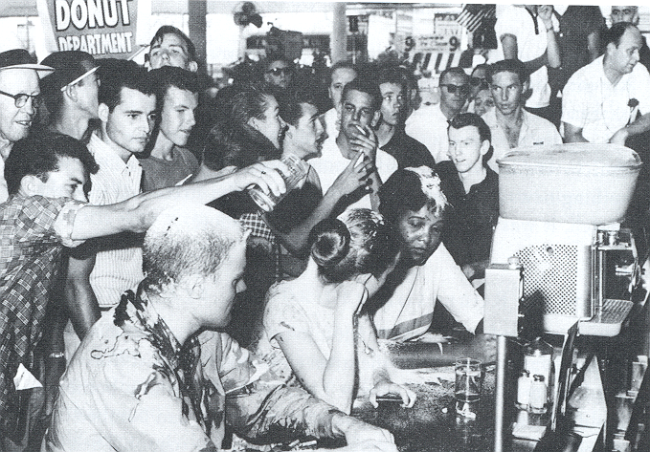
SS8H11b – Describe the role of individuals (Martin Luther King Jr. and John Lewis), groups (SNCC and SCLC) and events (Albany Movement and March on Washington) in the Civil Rights Movement.
Student Nonviolent Coordinating Committee- SNCC
One of the major civil rights organizations of the 1960’s
Formed in North Carolina, it worked with the SCLC and focused on orchestrating peaceful, nonviolent protests
The group, made up of high school and college-aged students, became known for sit ins, freedom rides, and the “freedom summer” in Mississippi.
SS8H11- The student will evaluate the role of Georgia in the modern civil rights movement..

Slide 37
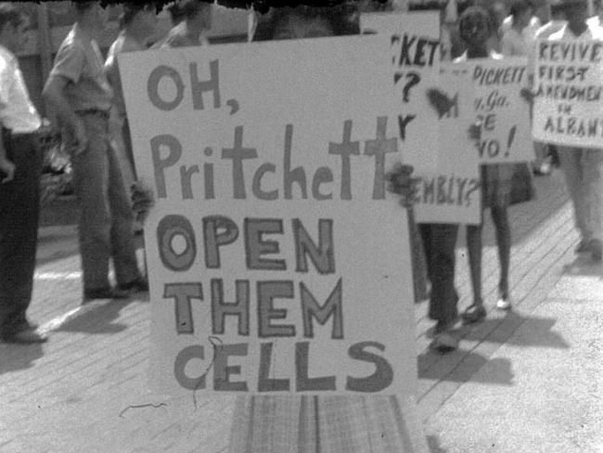
SS8H11b – Describe the role of individuals (Martin Luther King Jr. and John Lewis), groups (SNCC and SCLC) and events (Albany Movement and March on Washington) in the Civil Rights Movement.
Student Nonviolent Coordinating Committee- SNCC
In Georgia SNCC began its focus on the cities of Albany and Atlanta.
SNCC was at the forefront of the Albany Movement and although many considered it to be unsuccessful it helped the group later organize more successful protests
After moving their focus back to Atlanta in 1964, the group was successful in helping African Americans gain several General Assembly seats
SS8H11- The student will evaluate the role of Georgia in the modern civil rights movement..

Slide 38
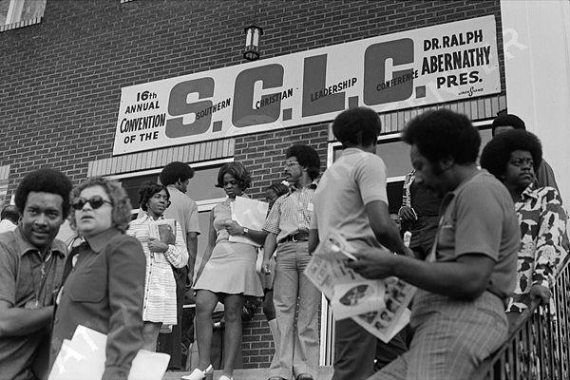
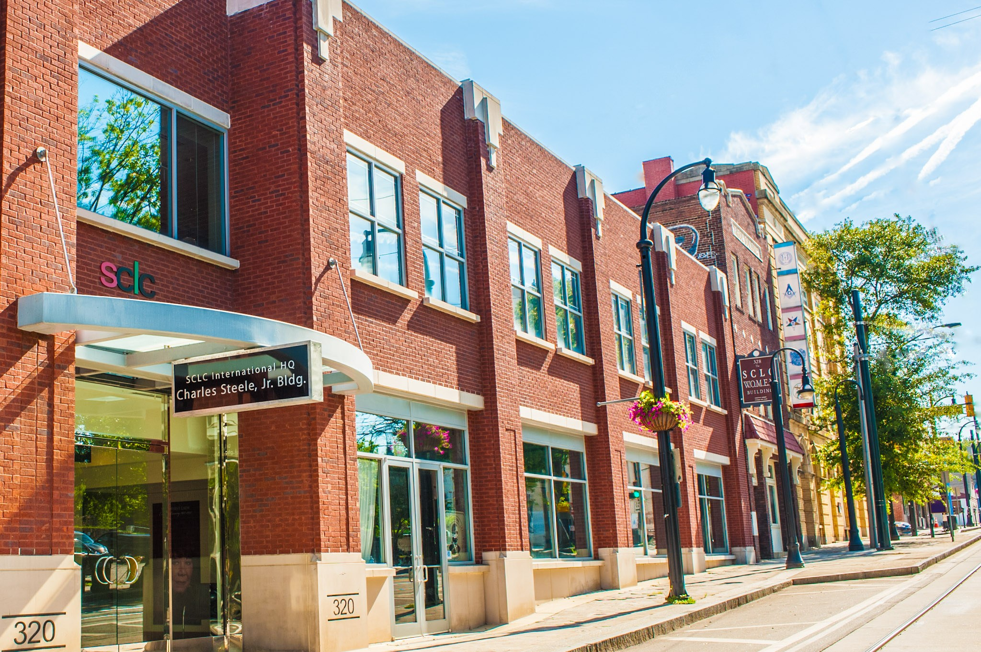
SS8H11b – Describe the role of individuals (Martin Luther King Jr. and John Lewis), groups (SNCC and SCLC) and events (Albany Movement and March on Washington) in the Civil Rights Movement.
Southern Christian Leadership Conference- SCLC
Created in 1957 in Montgomery, Alabama in reaction to the Montgomery Bus Boycott
Was led by MLK Jr. , who lived in Montgomery at the time and was supported by Southern religious leaders
The headquarters for the SCLC moved to Atlanta and filed lawsuits, planned rallies, marches and boycotts all to end segregation.
Though active throughout the Civil Rights movement the SCLC continues to strive for change today
SS8H11- The student will evaluate the role of Georgia in the modern civil rights movement..

Slide 39
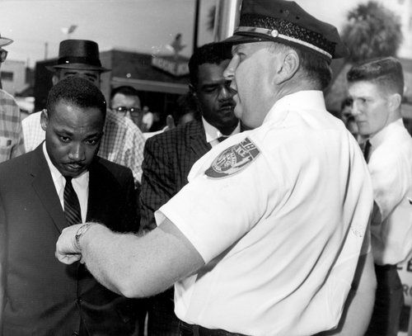
SS8H11b – Describe the role of individuals (Martin Luther King Jr. and John Lewis), groups (SNCC and SCLC) and events (Albany Movement and March on Washington) in the Civil Rights Movement.
Albany Movement
In 1961 SNCC and local community members began to protest the segregationist policies of the city of Albany, GA.
Led to over 500 protesters landing in jail
Unlike other protests Albany’s black middle class did not support the protests and the police chief used non-violent tactics to arrest the protesters
SNCC invited MLK to draw attention but nothing changed
While viewed as a failed attempt it was a valuable learning experience and led to the removal of segregationist laws
SS8H11- The student will evaluate the role of Georgia in the modern civil rights movement..

Slide 40
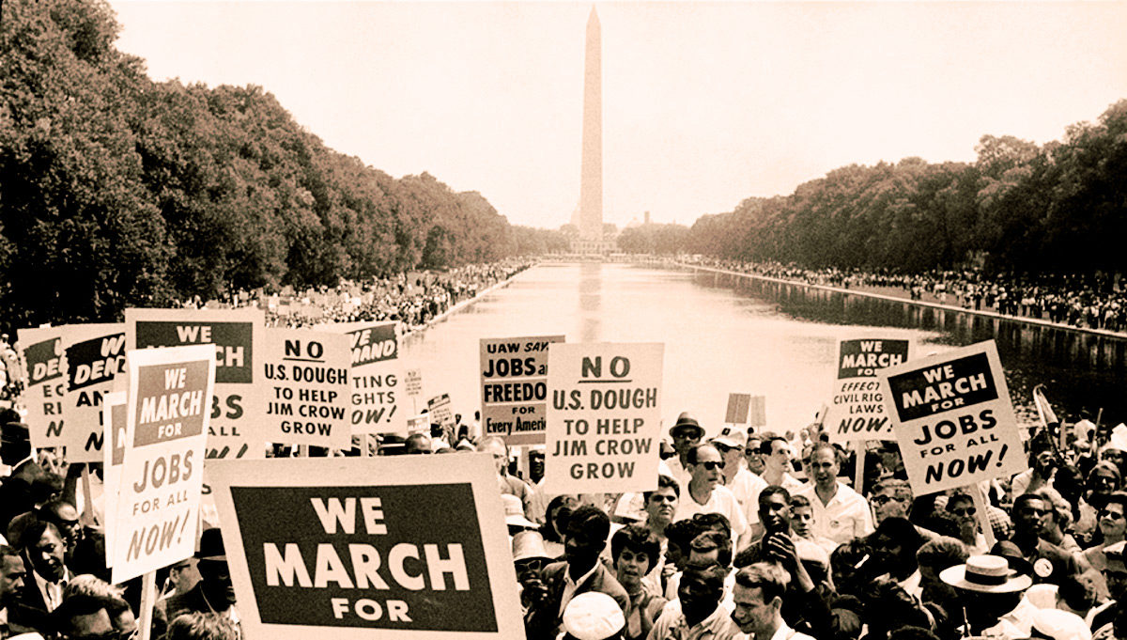
SS8H11b – Describe the role of individuals (Martin Luther King Jr. and John Lewis), groups (SNCC and SCLC) and events (Albany Movement and March on Washington) in the Civil Rights Movement.
March on Washington (for Jobs and Freedom)
In 1963 over 250,000 civil rights activists gathered in Washington D.C. to promote their cause and push for civil rights legislation.
MLK gave his famous “I Have a Dream” speech
The March on Washington encouraged the passage of the Civil Rights Acts of 1964 & The Voting Rights Act of 1965
It also made MLK the most well known spokesperson of the Civil Rights Movement
SS8H11- The student will evaluate the role of Georgia in the modern civil rights movement..

Slide 41
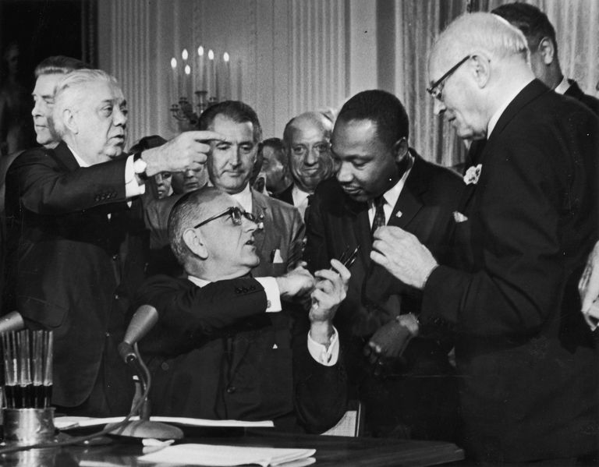
SS8H11c – Explain the resistance to the 1964 Civil Rights Act, emphasizing the role of Lester Maddox.
1964 Civil Rights Act
Signed by President Lyndon B. Johnson this act forbade discrimination on the basis of sex and race in hiring, promoting and firing.
Southern Congressional Democrats, led by Senator Richard Russell, strongly opposed the passage of the legislation
While some segregationist were determined to ignore the new law and respond with violence, most just accepted the law without passage
SS8H11- The student will evaluate the role of Georgia in the modern civil rights movement..

Slide 42
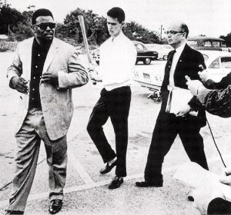
SS8H11c – Explain the resistance to the 1964 Civil Rights Act, emphasizing the role of Lester Maddox.
Lester Maddox
In 1947, Lester Maddox opened the Pickrick Cafeteria and refused to serve Black customers.
He was infamous for using axe handles, and on one occasion a gun, to remove African Americans from his restaurant
He later would close his restaurant rather than let it be integrated when he lost a court case
In 1966 Lester Maddox was selected by the GA Legislature as Governor, becoming the last overtly segregationist governor in the state’s history
Ironically he appointed more African Americans to government positions than all prior governors combined
He continued to fight against the civil rights platform during his career
SS8H11- The student will evaluate the role of Georgia in the modern civil rights movement..

Slide 43
Modern Georgia: Developments in the late 20th century

Slide 44
AKS 42: explain the importance of developments in Georgia since the late 20th century
Explain how the continued development of Atlanta under mayors Maynard Jackson and Andrew Young impacted the state.
Describe the role of Jimmy Carter in Georgia as state senator, governor, president, and past president.
Evaluate the short-term and long-term impacts of hosting the 1996 Olympics on Georgia’s economic and population growth.
Analyze Georgia’s role in the national and global economy of the 21st Century, with regard to tourism, Savannah port expansion, and the film industry.

Slide 45
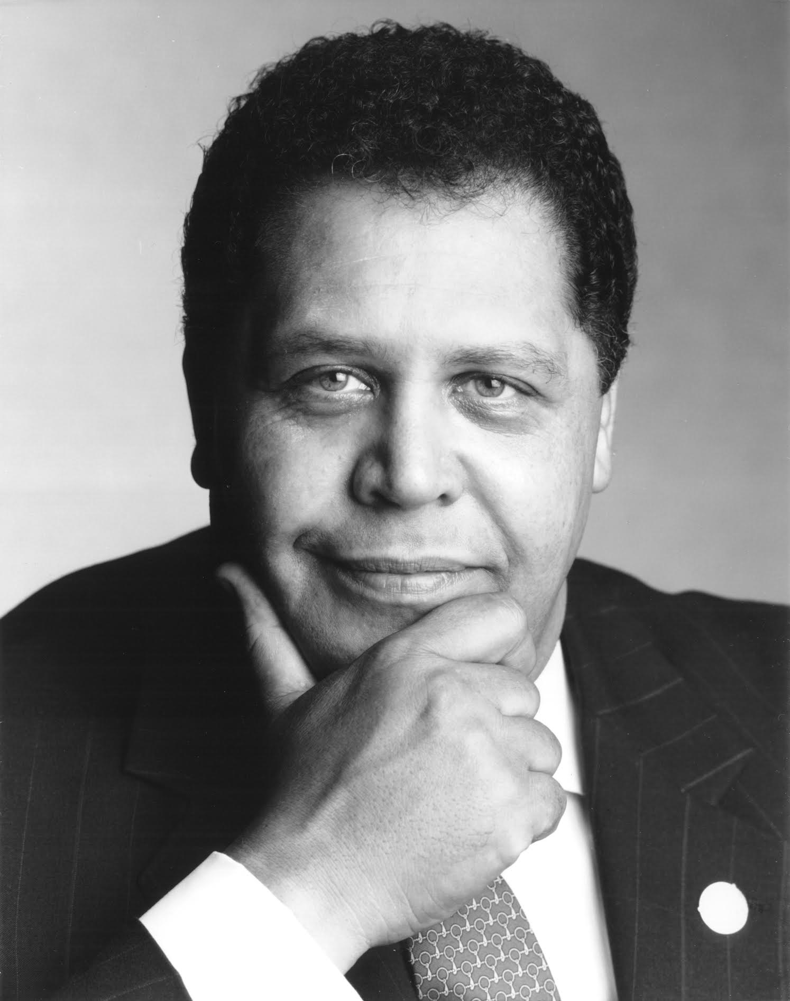
SS8H12a – Explain how the continued development of Atlanta under mayors Maynard Jackson and Andrew Young impacted the state.
Maynard Jackson (1938- 2003)
First Black mayor of a major southern city
Was only 35 at the time of his election
Served as mayor from 1973- 1981 and again from 1990- 1994
Helped develop Atlanta into a major city by:
Provide more work for black-owned businesses
Expand Hartsfield Atlanta International Airport
Sought to add more Black police officers and make sure blacks were promoted in the department
Encouraged Atlanta to become a financial center and distribution hub for the Southeast
Expanded international convention facilities and sold Atlanta’s image as a major convention center to the
Improved city housing and social conditions
Improved the mass transit system
Helped to bring the 96’ Olympics to the city
SS8H12- The student will explain the importance of developments in Georgia since the late 20th century

Slide 46
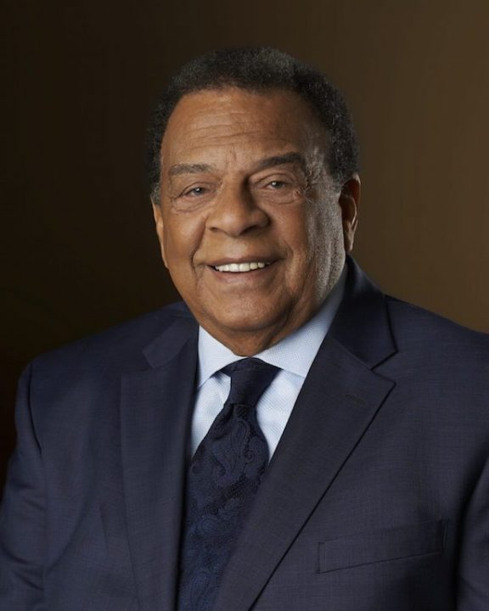
SS8H12a – Explain how the continued development of Atlanta under mayors Maynard Jackson and Andrew Young impacted the state.
Andrew Young (1932- )
Moved to GA when he accepted the position of pastor and became heavily involved with the SCLC.
In 1972 he was elected as GA’s first Black Congressman since Reconstruction and was appointed by Jimmy Carter as ambassador to the UN in 1977.
Was elected as mayor of Atlanta in 1981 and:
Brought $70 billion in new private investment to the city of Atlanta, 1,100 new businesses and one million jobs to the region
Expanded programs for including minority and female-owned businesses in all city contracts.
Tripled college scholarships given to Atlanta public school graduates
Overhauled Zoo Atlanta
Helped bring Olympics to GA
SS8H12- The student will explain the importance of developments in Georgia since the late 20th century

Slide 47
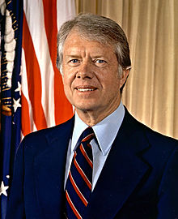
SS8H12b – Describe the role of Jimmy Carter in Georgia as state senator, governor, president, and past president.
Jimmy Carter (1924- )
State senator, governor, only person from Georgia to be elected as president and winner of the Nobel Peace Prize
As State Senator
Advocated for education and served as the chairman of the Senate Education Committee
Encouraged integration and had a pro-environment stand
As Governor
Reorganized state government
Improved Georgia’s educational, justice, mental health systems
Appointed more women and minorities to governmental positions than all of Georgia’s previous governors combined.
SS8H12- The student will explain the importance of developments in Georgia since the late 20th century

Slide 48
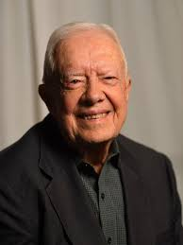
SS8H12b – Describe the role of Jimmy Carter in Georgia as state senator, governor, president, and past president.
Jimmy Carter (1924- )
Presidential Achievements:
Camp David Peace Accords between Egypt and Israel
Strategic Arms Limitation Treaty (SALT II) with the Soviet Union
Presidential Disappointments:
Boycott of the 1980 Olympic games
His management of the Iranian Hostage Crisis
And the overall perception that he did not do enough to fix the crippling U.S. economy
After Presidency
Founded the Carter Center which has monitored elections, resolved conflicts, and treated diseases world-wide.
Has supported and increased awareness of the Habitat for Humanity program
SS8H12- The student will explain the importance of developments in Georgia since the late 20th century

Slide 49
SS8H12c – Evaluate the short-term and long-term impacts of hosting the 1996 Olympics on Georgia’s economic and population growth.
1996 Olympics
Short-term impacts
New apartments, hotels and business structures
Infrastructure developments (road improvements, more sidewalks/ streetlights)
The clean up led to more people wanting to visit and enjoy the games
Improvements created interest in developing new attractions (Georgia Aquarium)
Long-term impacts
Number of hotel rooms in the city expanded to over 60,000
International recognition as a hub for conventions and sporting events
Population growth (3.5 million in 1996 to 5.5 million in 2011)
Olympics generated 5.1 billion dollars for the state
Declining housing market and traffic concerns
SS8H12- The student will explain the importance of developments in Georgia since the late 20th century

Slide 50
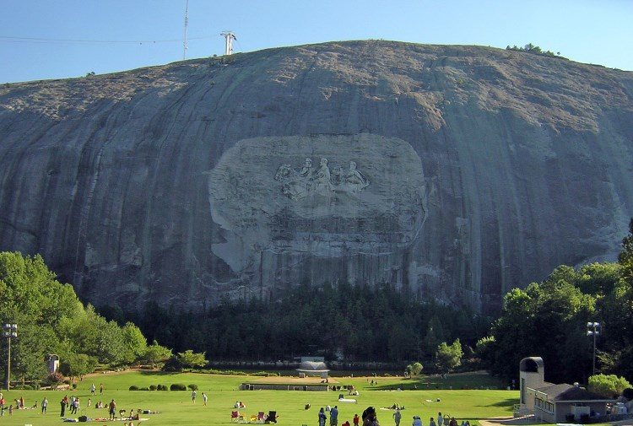
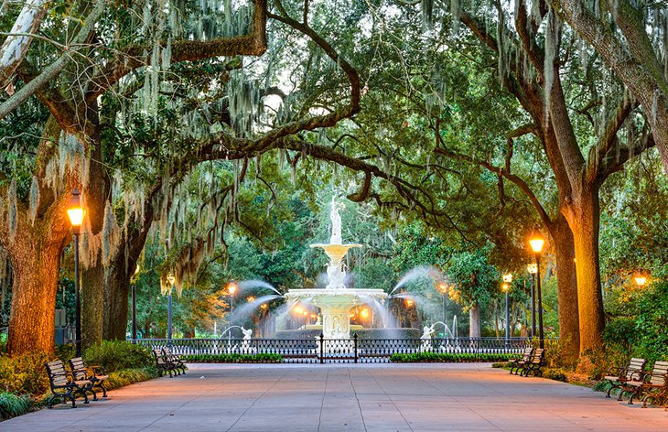
SS8H12d – Analyze Georgia’s role in the national and global economy of the 21st Century, with regard to tourism, Savannah port expansion, and the film industry
Georgia- Tourism
One of the state’s largest industries
Has become the 5th largest employer in the state
$59 billion dollars in revenue providing 439,000 jobs
In 2016 the tourism industry generated $3 billion in taxes and employed 10.2% of Georgia’s workforce
1/3 of tourists were Georgians enjoying regional attractions
SS8H12- The student will explain the importance of developments in Georgia since the late 20th century

Slide 51
SS8H12d – Analyze Georgia’s role in the national and global economy of the 21st Century, with regard to tourism, Savannah port expansion, and the film industry
Georgia- Savannah Port Expansion
Savannah’s port is the fourth-busiest container port in the U. S. and is the fastest growing port.
The expansion project will deepen the outer port allowing larger shipments to go though the canal
The expansion of Savannah Harbor will generate $67 billion in revenue.
More than 350,000 jobs will be impacted and about $18.5 billion in personal income will impact the region.
The expansion will help manufacturers on the national and global level
SS8H12- The student will explain the importance of developments in Georgia since the late 20th century

Slide 53
SS8H12d – Analyze Georgia’s role in the national and global economy of the 21st Century, with regard to tourism, Savannah port expansion, and the film industry
Georgia- Film Industry
Due to financial incentives, diversity of locations for filming and growing resources/ support Georgia is the destination in the southeast for film production
Moderate climate allows for year round productions and the airport allows for quick transportation
The film industry had a $7 billion impact in 2016
The Georgia Film Academy and colleges and universities will help fill the projected 3,500 - 5,500 job opportunities by 2021
With 800 film and television projects since 1972
SS8H12- The student will explain the importance of developments in Georgia since the late 20th century

