Slide 1
The Creation of Israel

Slide 2
SS7H2 Analyze continuity and change in Southwest Asia (Middle East).
Explain the historical factors contributing to the establishment of the modern State of Israel in 1948; include the Jewish religious connection to the land, antisemitism, the development of Zionism in Europe, and the aftermath of the Holocaust.

Slide 3
Palestine
In July 1922, Great Britain officially took control of Palestine as a mandate (similar to a colony).
Under British occupation, waves of Jewish immigrants poured into Palestine to escape religious persecution in Europe.
In 1920, there was 1 Jew to every 10 Arabs.
By 1947, there was 1 Jew for every 2 Arabs.
The Arabs felt that they were losing control of their land, and tension between Arabs and Jews increased.
Notes:
Students don’t have to write the exact number of Jews in 1920 or 1947. They just need to know there was an increase in the amount of Jews in Palestine

Slide 4
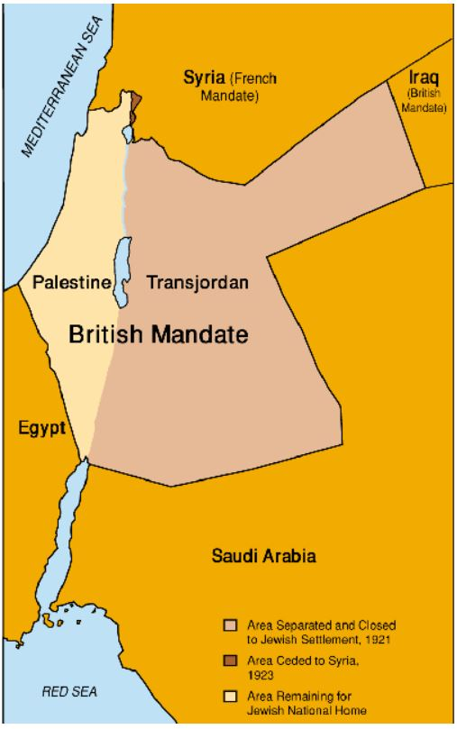
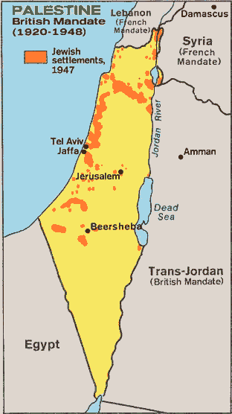

Slide 5
Reasons for creation of Israel
1.Zionism
2. Jewish land
3. Anti-Semitism
4. Holocaust

Slide 6
Zionism
Led by Theodor Herzl in 1890’s
The goal of Zionism was to establish a Jewish homeland in Palestine secured by public law.
The Jewish people believed that this was a good time to return to Zion (the holy land).
Tens of thousands of Jews began moving to Palestine after the Zionist movement began.

Slide 7
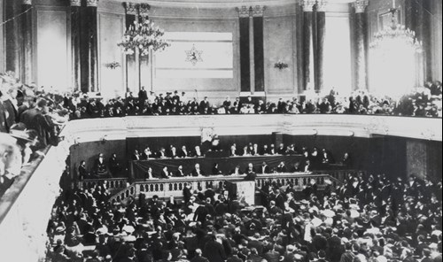

Slide 8
Jewish Land
According to Jewish and Christian holy texts God gave this land to his people the Israelites
The Jews have a religious connection to the land and all of their sacred places are located there.

Slide 9
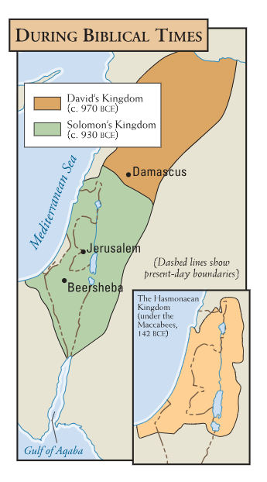
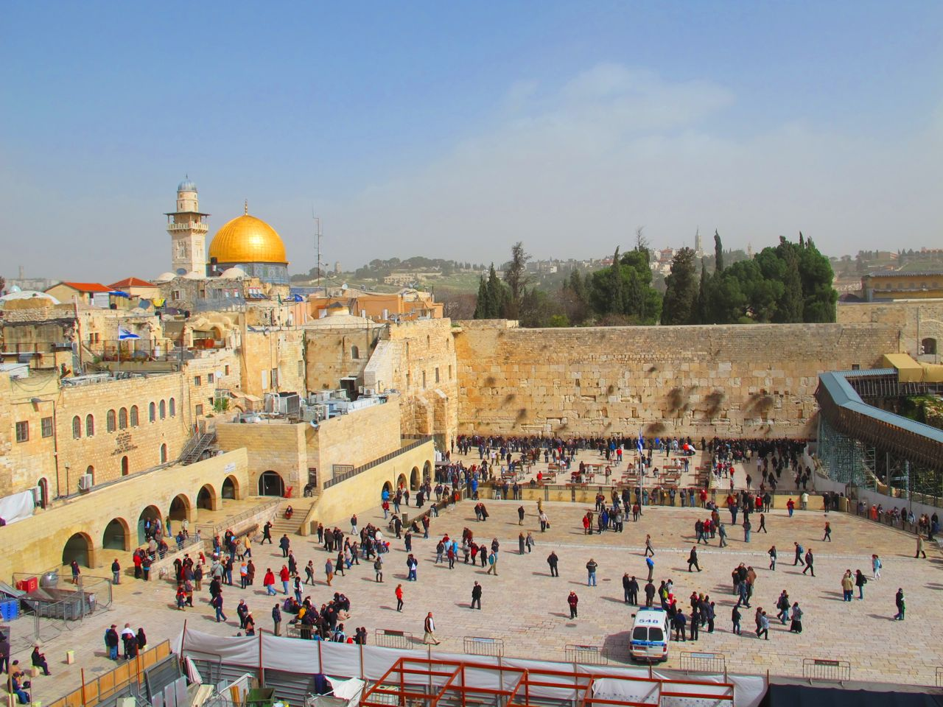

Slide 10
Anti Semitism
Europeans had been discriminating against Jews for centuries in a practice called anti-Semitism.
Many people believed the Jews to be an inferior race
Anti-Semitism grew enormously in the 1930s when Adolf Hitler and the Nazi party came to power in Germany.
Hitler blamed the Jews for Germany losing WWI.
Anti-Semitism spread throughout Europe as Hitler forced other countries to persecute the Jews.

Slide 11
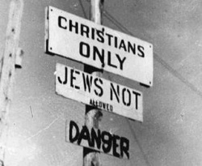
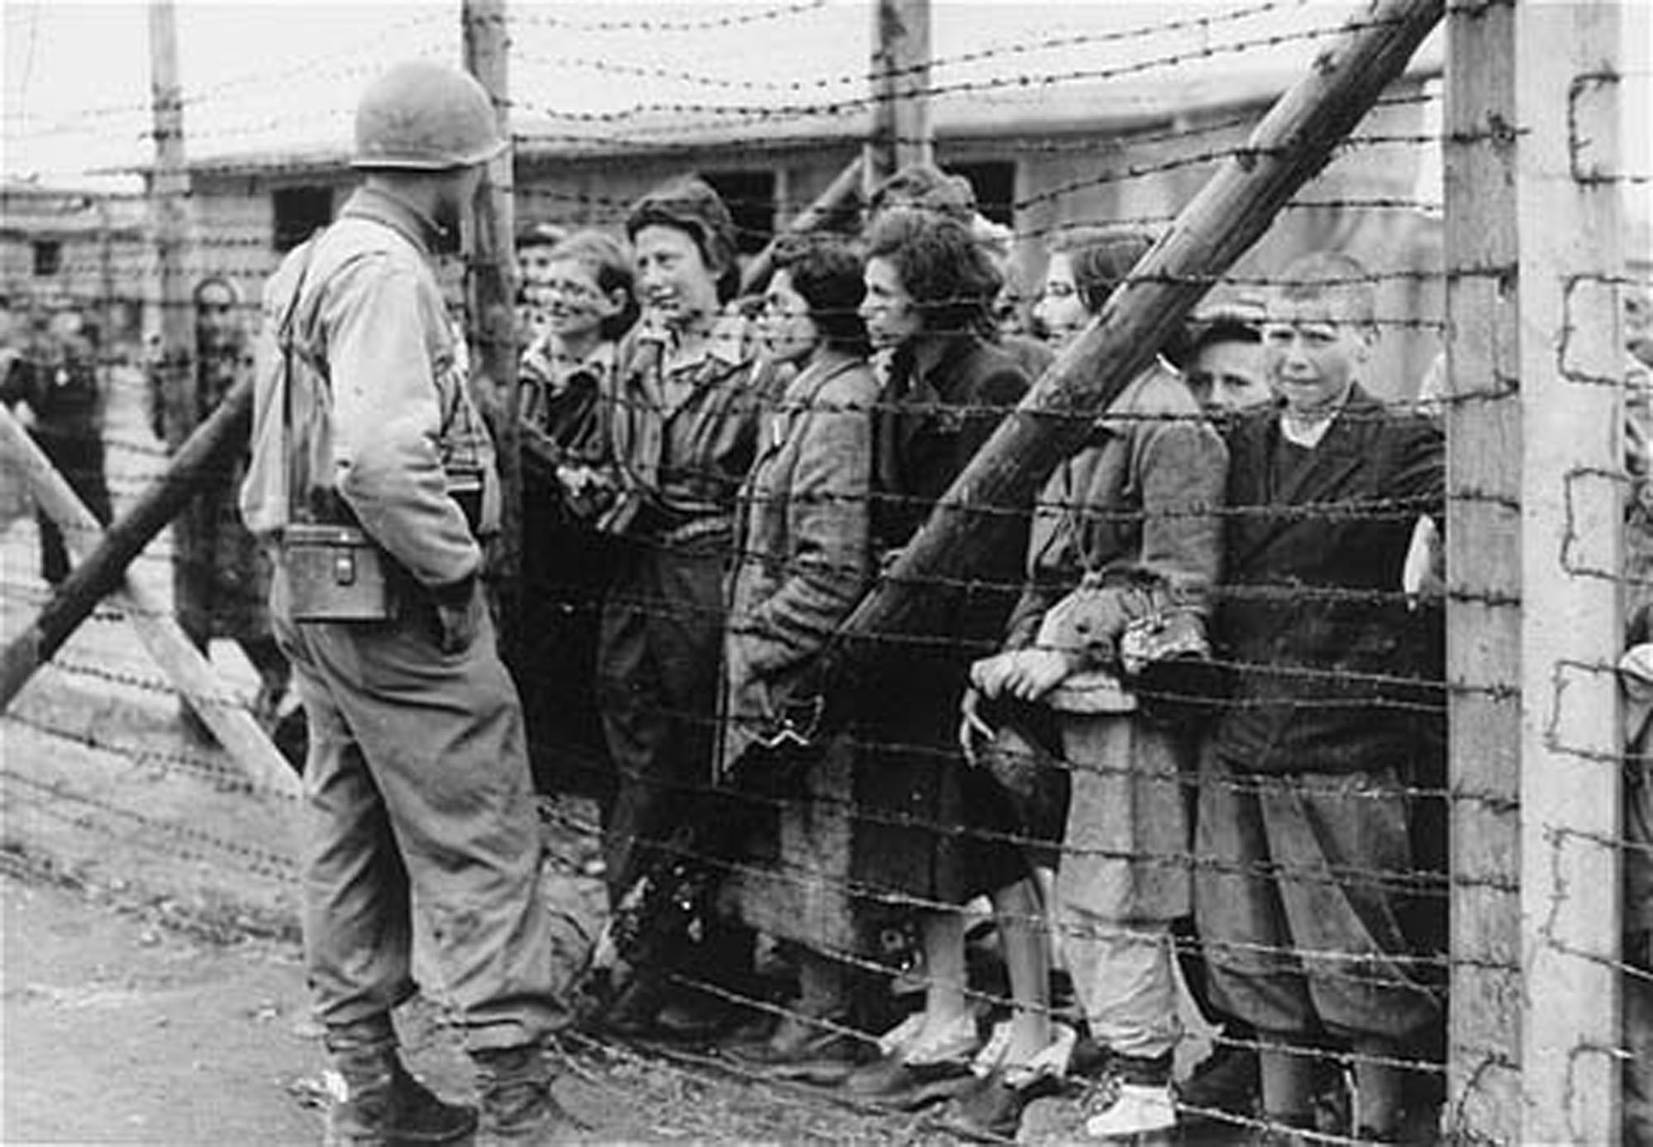
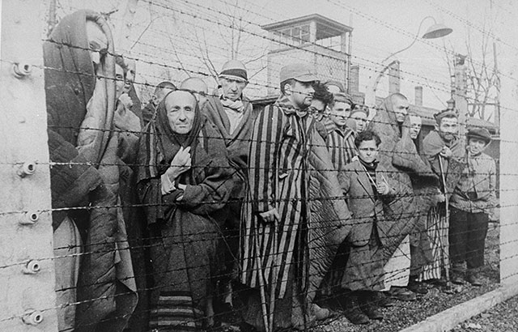

Slide 12
Holocaust
The Holocaust was the systematic, state-sponsored killing of 11 million innocent people (6 million of whom were Jewish).
It began in 1933, when Hitler and the Nazis came to power in Germany, and lasted until 1945.
Hitler targeted men, women, and children that he believed to be inferior to “pure” Germans.

Slide 13
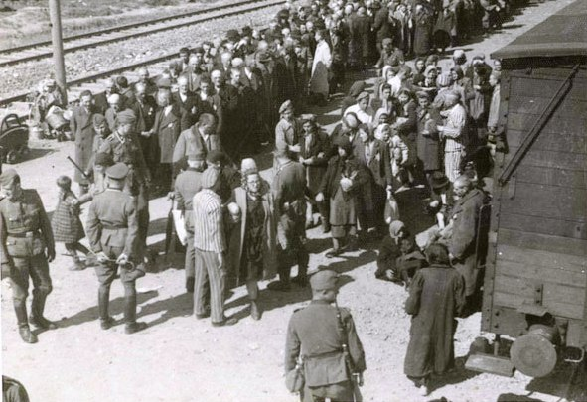

Slide 14
