Slide 1
Review Practice!
Are you tired?
Does he have fair skin? (2nd form)
Who bought my book?
What Chinese music do you listen to?
Where did she buy that Christmas tree (shù)?
Who is my teacher calling?
Why are you running?
Where is the bathroom?
When are you going to close the door?
Which donut (tián tián quān) do you not like?
How is the fried rice?
How do you eat fried rice?

Slide 2
jǐ (几)
How Many/How Much
Less than 10
Always followed by a measure word/counter

Slide 3
Expressing “How many/How Much” with “jǐ” (几)
Structures
Subj. + Verb + 几 + counter + (Noun) ?
Examples:
Subjects
ní - you wǒ – me/I tā – he/she tā men - they wǒ men – we/us zhè - this nà – that
nǐ men – you guys
Verbs
have
want
eat
drink
Classifier/Counters/Measure Words
ge - general classifier tiáo – long, skinny, flexible objects zhǐ - animals, one of a pair bēi - cup bāo - bag běn - counter for books shuāng – counter for pairs

Slide 4
Structure Q: Subj. + Verb + 几 + Counter + (Noun)?
A: Subj. + Verb + Number + Counter + (Noun).
Examples (this one doesn’t fit the typical structure):
A: 你 几 岁 ？ Nǐ jǐ suì?
How old are you?
B: 我 十三 岁。 Wǒ 13 suì.
I am 13 years old.
A: 你 有 几 只 狗？ Nǐ yǒu jǐ zhǐ gǒu?
How many dogs do you have?
B: 我 有 两 只 狗. Wǒ yǒu liǎng zhǐ gǒu.
I have two dogs.

Slide 5
Structure Q: Subj. + Verb + 几 + Counter + (Noun)?
A: Subj. + Verb + Number + Counter + (Noun).
Examples:
A: 你 要喝 几 杯 水？ Nǐ yào hē jǐ bēi shuǐ?
How many cups of water do you want to drink?
B: 我 要喝 八 杯 水. Wǒ yào hē bā bēi shuǐ.
I want to drink 8 cups of water.
A: 你的家 有 几 口 人？ Nǐ de jiā yǒu jǐ kǒu rén?
How many people are in your family?
B: 我 的家 有 五 口 人. Wǒ de jiā yǒu wǔ kǒu rén.
My family has 5 people.

Slide 6
Duōshǎo (多少)
How Many/How Much
More than 10
Measure word/counter after is optional

Slide 7
Structure Q: Subj. + Verb + 多少 (Duōshǎo) + (Counter - optional) + (Noun)?
A: Subj. + Verb + Number + (Counter – optional) + (Noun).
Examples:
A: 你 有 多少 钱？ Nǐ yǒu duōshǎo qián?
How much money do you have?
B: 我 有 二十 美元. Wǒ yǒu èrshí Měiyuán.
I have 20 American dollars.
A: 你 看了 多少 (部) 电影？ Nǐ kàn le duōshǎo (bù) diànyǐng?
How many movies have you watched?
B: 我 看了 三十四 (部) Marvel电影. Wǒ kàn le 34 (bù) Marvel diànyǐng.
I have watched 34 Marvel movies.

Slide 8
Structure Q: Subj. + Verb + 多少 (Duōshǎo) + (Counter - optional) + (Noun)?
A: Subj. + Verb + Number + (Counter – optional) + (Noun).
Examples:
A: 她 有 多少 (个) 学生？ Tā yǒu duōshǎo (ge) xuéshēng?
How much students does she have?
B: 她 有 五十七 (个) 学生. Tā yǒu wǔshíqī (ge) xuéshēng.
She has 57 students.
A: 外面的温度 是 多少度？ Wàimiàn de wēndù shì duōshǎo dù?
How many degrees is it outside?
B: 外面的温度 是 一百 度. Wàimiàn de wēndù shì yī bǎi dù.
The outside temperature is 100 degrees.

Slide 9
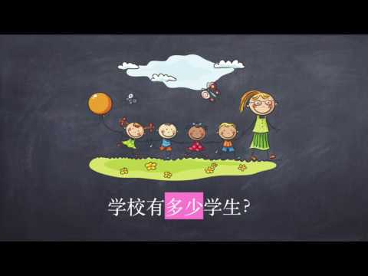

Slide 10
Practice
Structure
几 (Jǐ): Subj. + Verb + 几 + Counter + (Noun)? 多少 (Duōshǎo): Subj. + Verb + 多少 (Duōshǎo) + (Counter - optional) + (Noun)?
How many cups of coffee will you drink?
How many kids do you have?
How many Christmas presents (lǐwù) will you buy?
How many days (tiān) do we need to wait?
How much money (qián) was your car?
In your book, how many pages (yè) have you read?
How much is 6 x 4? (multiply = chéng)
What time (diǎn) is it now?

Slide 11
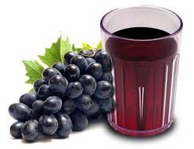
Mixed Review! ☺ (HOORAY! YOU’RE DONE AFTER THIS!)
Do you drink apple juice? (1st form)
Do you drink grape juice? (2nd form)
What (kind of) juice do you drink?
Why do you drink juice?
When do you drink juice?
Who drinks grape juice?
Where do you drink juice?
Which juice do you drink?
How is the apple juice?
How much juice do you drink?
How many cups of juice do you drink?
Nǐ hē píng guǒ zhī ma?
Nǐ hē bu hē pú táo guǒ zhī?
Nǐ hē shén me guǒ zhī?
Nǐ wèi shén me hē guǒ zhī?
Nǐ shén me shí hòu hē guǒ zhī?
Shéi hē pú táo guǒ zhī?
Nǐ zài nǎ lǐ hē guǒ zhī?
Nǐ hē nǎ ge guǒ zhī?
Píng guǒ guǒzhī zěn me yàng?
Nǐ hē duōshǎo guǒzhī?
Nǐ hē jǐ bēi guǒzhī?

Slide 12
Mixed Review! ☺ (HOORAY! YOU’RE DONE AFTER THIS!)
Do you eat Skittles? (1st form)
Do you eat M&Ms? (2nd form)
What (kind of) candy do you eat?
Why do you not eat candy?
When do you eat candy?
Who likes to eat Snickers?
Where do you eat candy?
Which candy do you eat?
How do you eat candy?
How is the candy?
How many bags of candy did you eat?
Nǐ chī Skittles ma?
Nǐ chī bu chī M&Ms?
Nǐ chī shén me táng guǒ?
Nǐ wèi shén me bù chī tang guǒ?
Nǐ shén me shí hòu chī tang guǒ?
Shéi xǐ huān chī Snickers?
Nǐ zài nǎ lǐ chī táng guǒ?
Nǐ chī nǎ ge táng guǒ?
Nǐ zěnme chī tángguǒ?
Tángguǒ zěnme yang?
Nǐ chī le jǐ bāo tángguǒ?

Slide 13
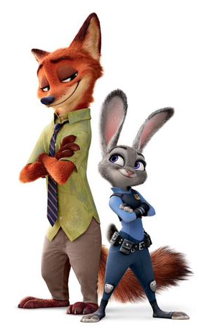
Mixed Review! ☺ (HOORAY! Last Question word!)
What is this movie?
What (kind of) movie do you like?
Do you like to watch Toy Story? (1st form)
Do you like to watch Zootopia? (2nd form)
Why do you watch movies?
Why do you not like to watch movies?
When do you watch scary (kǒng bù) movies?
Who likes to watch Despicable Me?
Who does not like scary movies?
Where do you watch movies?
Which scary movie are you watching?
How do you watch scary movies?
How is the scary movie?
How many movies have you watched today?
How many characters (zìfú) are in Toy Story?
Zhè shì shén me diàn yǐng?
Nǐ xǐ huān shén me diàn yǐng?
Nǐ xǐ huān kàn Toy Story ma?
Nǐ xǐ bu xǐ huān kàn Zootopia?
Nǐ wèi shén me kàn diàn yǐng?
Nǐ wèi shén me bù xǐ huān kàn diàn yǐng?
Nǐ shén me shí hòu kàn kǒng bù diàn yǐng?
Shéi xǐ huān kàn Despicable Me?
Shéi bù xǐ huān kǒng bù diàn yǐng?
Nǐ zài nǎ lǐ kàn diàn yǐng?
Nǐ kàn nǎ ge kǒng bù diàn yǐng?
Nǐ zěnme kàn kǒngbù diànyǐng?
Kǒngbù diànyǐng zěn me yàng?
Jīntiān, nǐ kàn le jǐ bù diànyǐng?
Toy Story yǒu duōshǎo (ge) rénwù?

