Slide 1
Essential Question: How have environmental issues affected Latin America?
Standard:
SS6G2a. Explain the major environmental concerns of Latin America regarding issues of air pollution in Mexico City, Mexico, the destruction of the rain forest in Brazil, and oil-related pollution in Venezuela.

Slide 2
Air Pollution in Mexico City

Slide 3
Causes of Pollution in Mexico City
Overcrowding
Industrialization
Vehicle emissions (releases)
Location of Mexico City

Slide 4
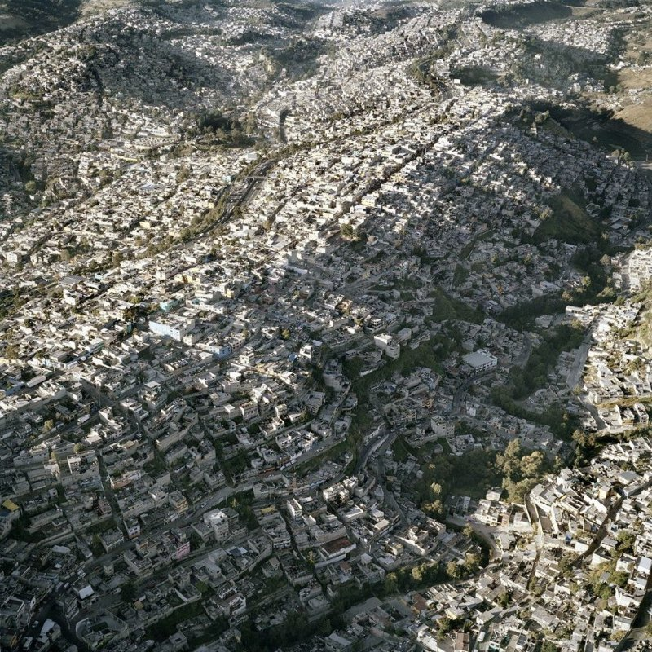
Overcrowding in Mexico City

Slide 5
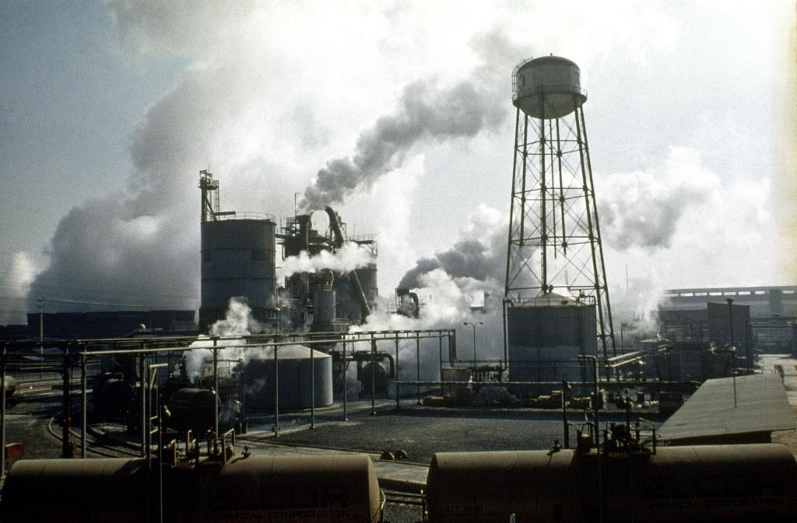
Industrialization in Mexico City

Slide 6
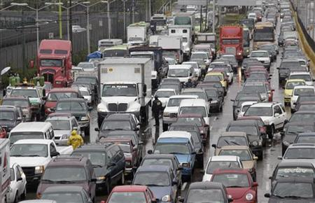
Vehicle Emissions in Mexico City

Slide 7
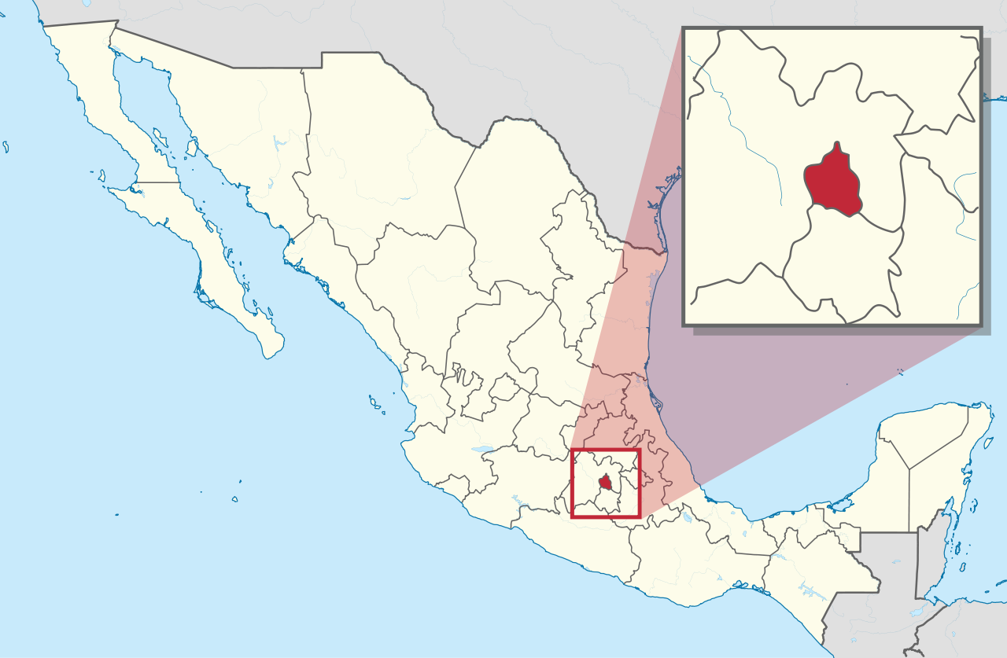
Location of Mexico City
Based on what you’ve learned about Mexico’s physical features, how does its location matter?

Slide 8
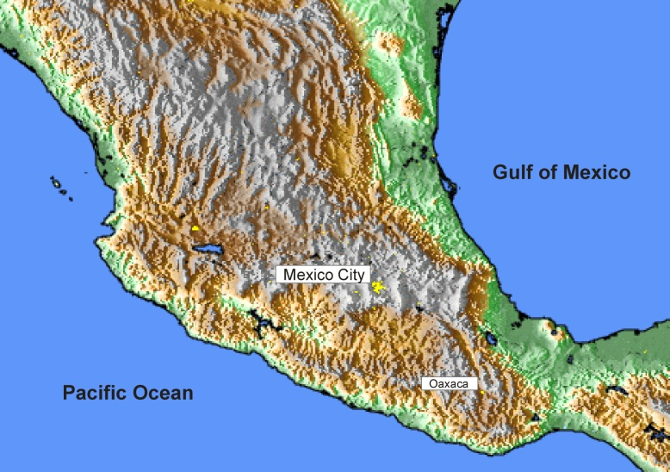
Location of Mexico City
Mexico City lies at the base of two mountain ranges which basically traps the air pollution

Slide 9
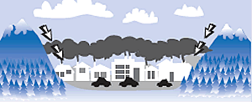
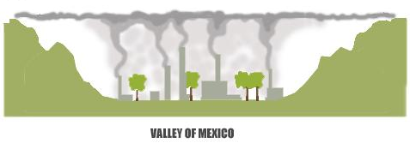

Slide 10
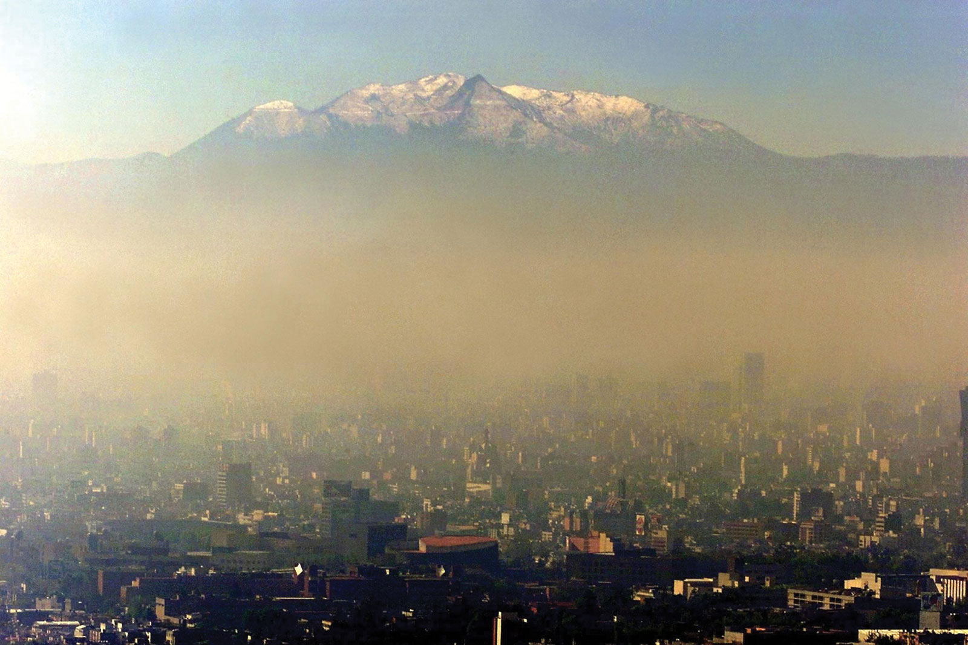
Air Pollution in Mexico City

Slide 11
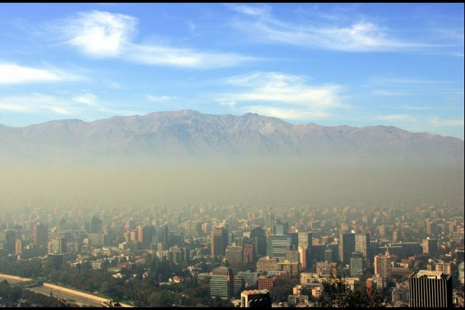
Air Pollution in Mexico City

Slide 12
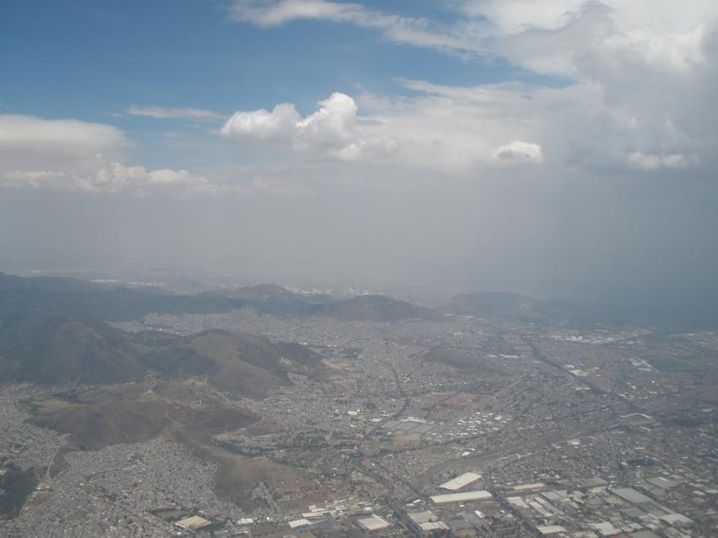
Air Pollution in Mexico City

Slide 13
Effects of Pollution in Mexico City
Damage to vegetation (plants)
Harm to the atmosphere
Harm to human beings
Pollution causes Acid Rain

Slide 14
Video on Air Pollution in Mexico [select one]
Mexico City Air Pollution [6:10]
Air Pollution in Mexico City Documentary [10:57]

Slide 15
Destruction of the Rainforest in Brazil
Time Lapse Devastating Deforestation

Slide 16
Importance of Rainforests
Rainforests are known as the “lungs of the earth”. Why?
Rainforests help convert carbon dioxide into oxygen

Slide 17
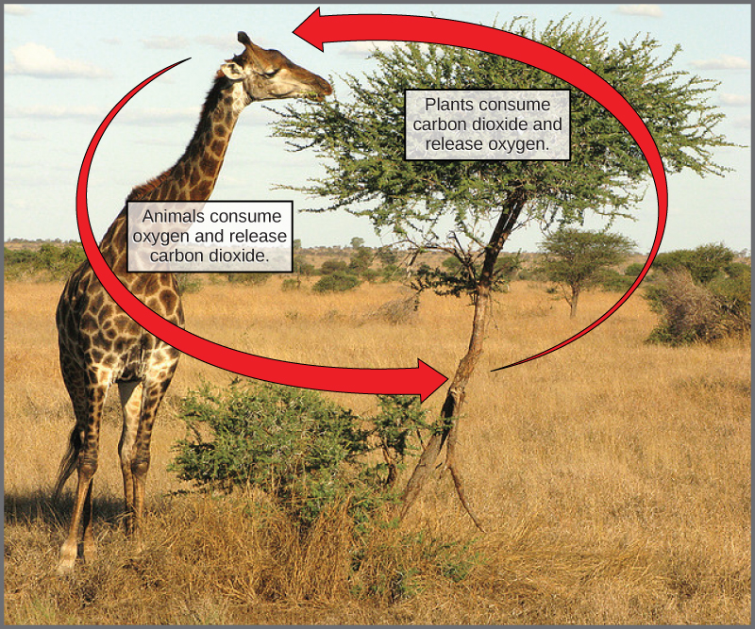
Tropical Rainforests have very dense (thick) vegetation; therefore, they consume a lot of carbon dioxide and give off a lot of oxygen.

Slide 18
Importance of Rainforests
Rainforests are the home to the largest variety of plant and animal species on the planet

Slide 19
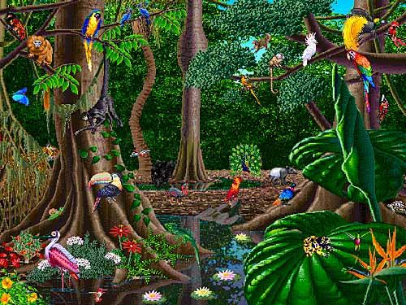
Diversity of Living Things in the Rainforest

Slide 20
Causes of the Destruction of the Rainforest in Brazil
Road building
Farmers cutting down forests to plant crops
Cattle ranching
Logging
Mining
New settlements

Slide 21
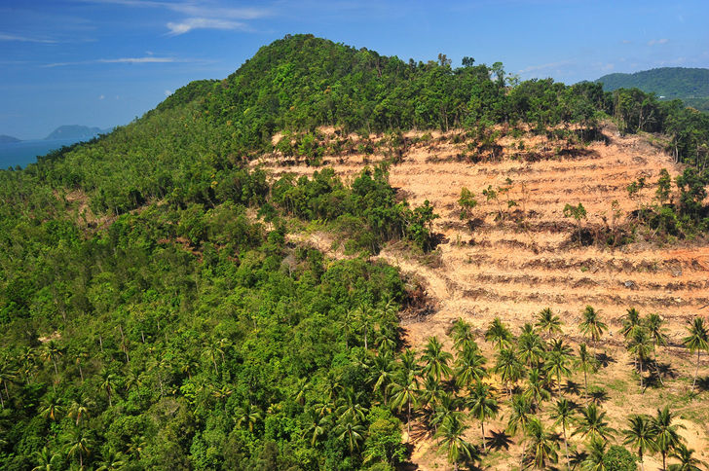
Destruction of Rainforest in Brazil

Slide 22
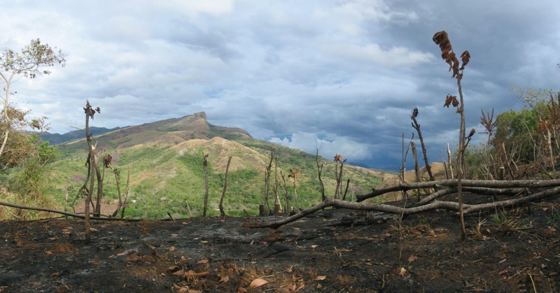
Destruction of Rainforest in Brazil

Slide 23
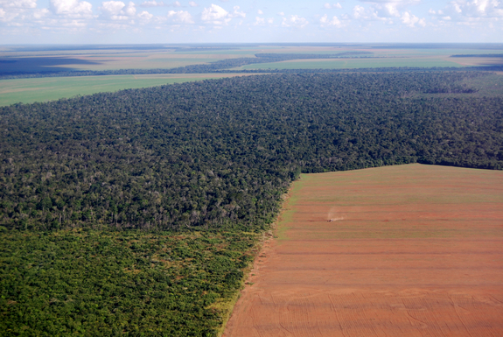
Destruction of Rainforest in Brazil

Slide 24
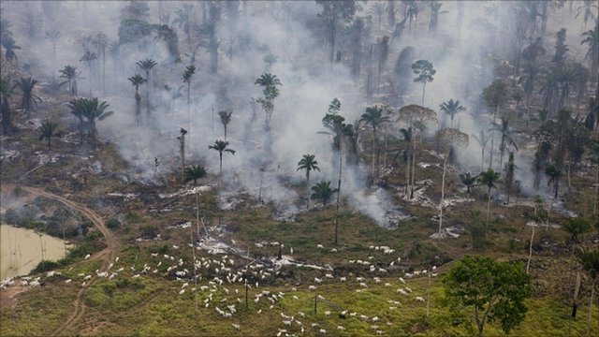
Destruction of Rainforest in Brazil

Slide 25
Effects of the Destruction of the Rainforest in Brazil
Causes a loss of habitat for species
Can cause climate change (more carbon dioxide in the atmosphere)
Causes less clean air for humans

Slide 26
Effects of the Destruction of the Rainforest in Brazil
Causes more soil erosion (trees help keep soil from eroding)
Causes soil depletion (rainforests have rich soil but when cut down the richness of the soil is reduced)

Slide 27
Video on Deforestation in Brazil [see resources]

Slide 28
Oil-related Pollution in Venezuela

Slide 29
Oil-related Pollution in Venezuela
Oil is an important natural resource in Venezuela accounting for 50% of the government’s revenue (income)
Occasional oil spills have killed fish, damaging the environment and fishing industry

Slide 30
Oil-related Pollution in Venezuela
Oil spills have also shut down tourist resorts
Contaminated oil pits, which collect waste from oil wells, can leak into Venezuela’s water sources

Slide 31
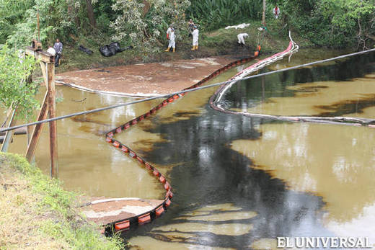
Oil Spill in Venezuela

Slide 32
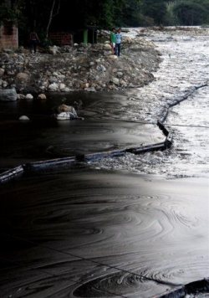
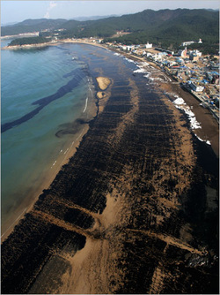
Oil-related Pollution in Venezuela

Slide 33
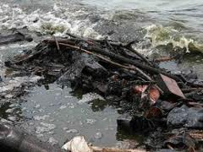
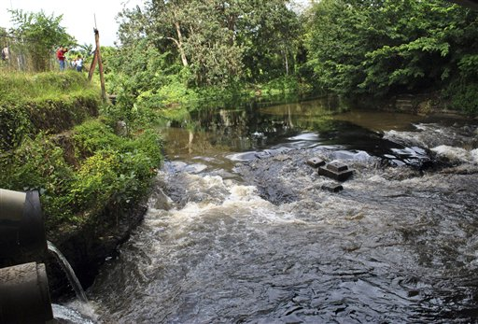
Oil-related Pollution in Venezuela
https://www.youtube.com/watch?v=7CXqRLUBt5c

Slide 34
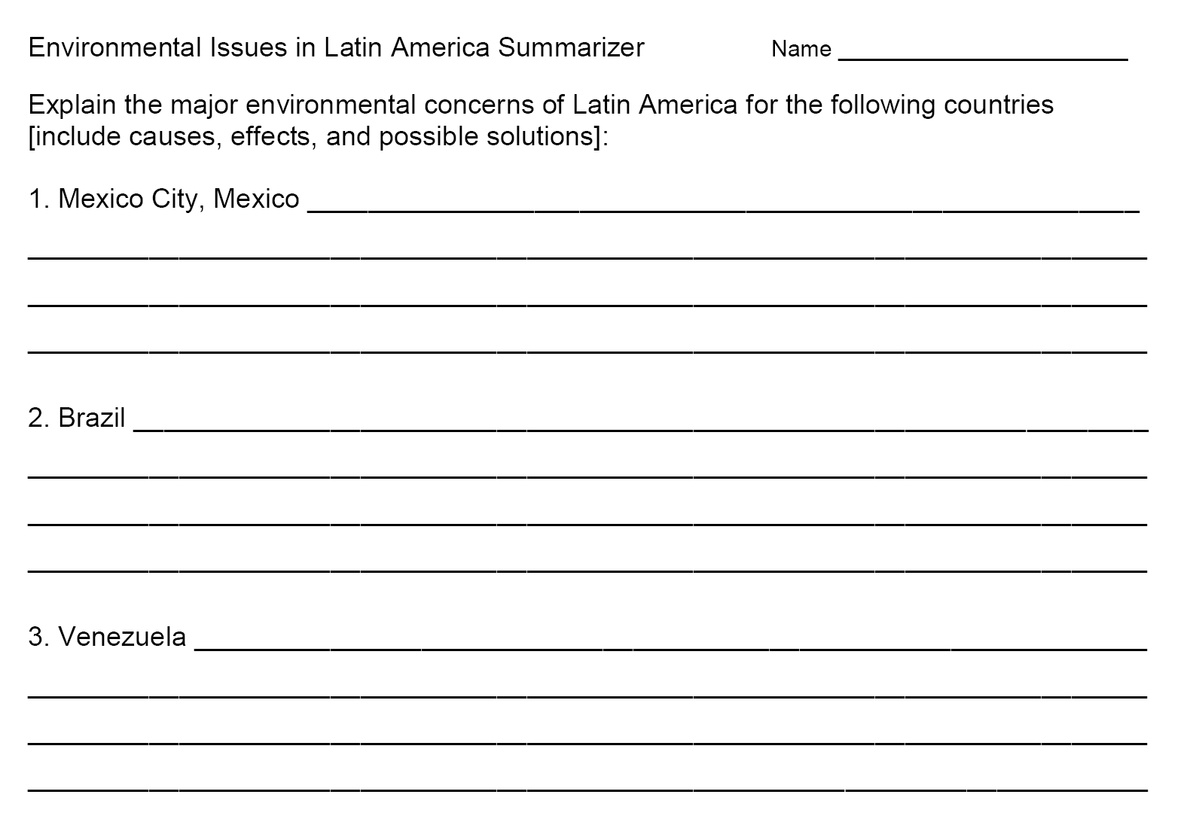
Summarizer

