Slide 1
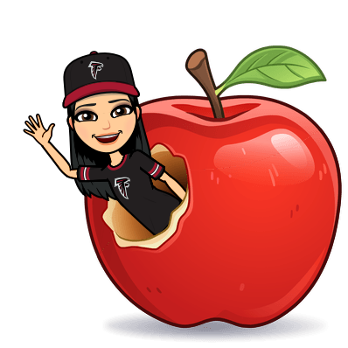
[2.1] Basics - Greetings
By: Gāo Lǎoshī (高老师)

Slide 2
Understanding Chinese to English Sentence Structures
Your brain does 2 things when you are learning the Chinese language: it translates twice.
When going from English → Chinese, you need to turn sentences/phrases into “Incorrect English”/“Broken English” and then translate to Chinese in new order.
The same applies when you go from Chinese → English.
Chinese → Broken English → Correct English
**It’s important to note that every character/syllable in Chinese has a meaning.

Slide 3
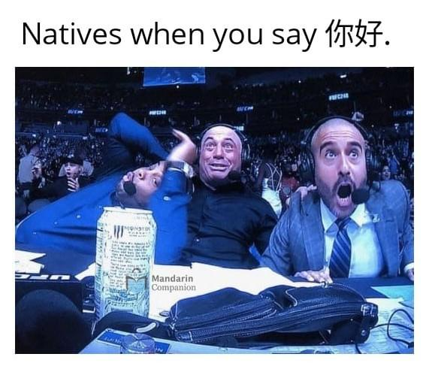
Hello/How are You?
Nǐ hǎo (你好) - Hello
Nǐ (你) = you
hǎo (好) = good
So when you say “Nǐ hǎo (你好)” to someone, you are literally asking them, “You good.”
If you want to ask them “How are you?”, you usually say:
Nǐ hǎo ma (你好吗)? - You good yes/no?

Slide 4
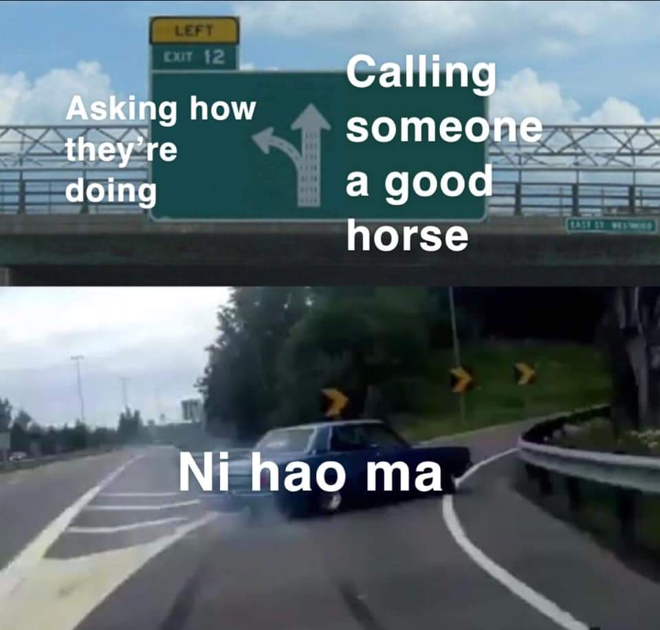
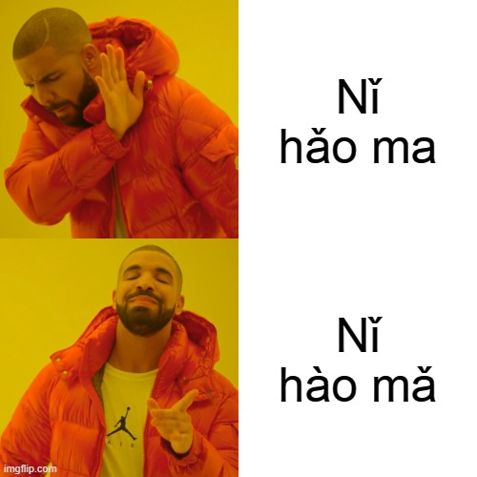
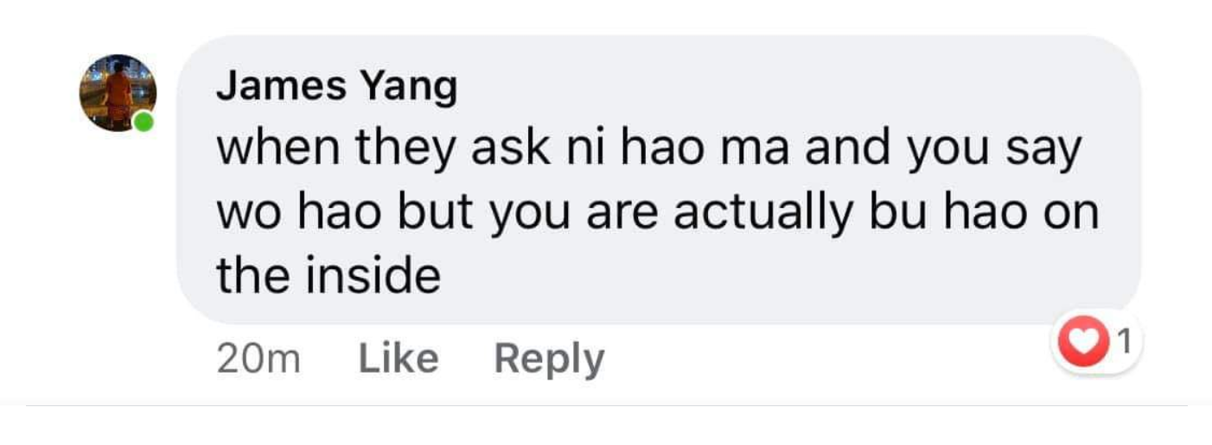
Meme Time!

Slide 5
What is your name?
Nǐ jiào shénme míngzi? (你叫什么名字?)
Nǐ (你) = you
jiào (叫) = call
shénme (什么) = what
míngzi (名字) = name
Broken English = You call what name?
In correct English, we say:
What is your name?
What are you called?

Slide 6
I’m called...
Wǒ jiào... (我叫...)
Wǒ (我) = I/me
jiào (叫) = call
Broken English = I call…
In correct English, we say:
I’m called…
I am called…

Slide 7
My name is...
Wǒ de míngzi shì... (我的名字是...)
Wǒ de (我的) = My/mine
míngzi (名字) = name
shì (是) = is/am/are
Broken English = My name is...
Sometimes the “Broken English” and the “Correct English” are the same, which makes it easy!

Slide 8
Thank you/You’re welcome
xiè xiè (谢谢) = thanks
You can say “xiè xiè nǐ (谢谢你)” = thank you
bù kè qi (不客气) = you’re welcome
bù (不) = no
kè qi (客气) = polite
It’s almost like saying “no need to be polite” or “no worries”
Sometimes people also say “bù xiè (不谢)”, which doesn’t mean “no thanks” - instead it implies “no need to thank”

Slide 9
I’m sorry/Excuse me
Duì bù qǐ (对不起) = I’m sorry/excuse me
Duì (对) = correct
bù qǐ (不起) = can’t afford
Almost means “can’t afford to be correct”.
Basically used when saying “I’m sorry” or “Excuse me”.

Slide 10
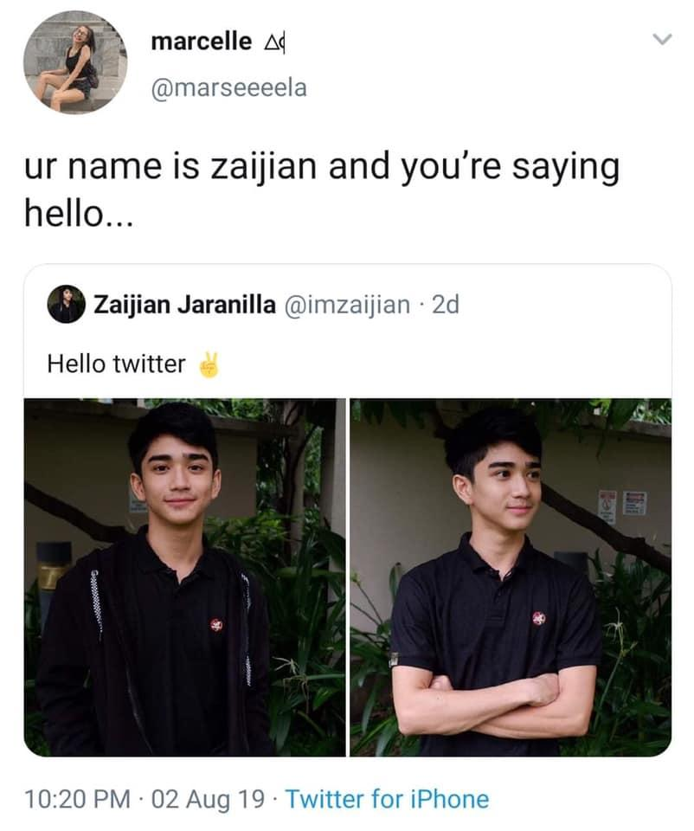
(Good)bye
zài jiàn (再见) - (Good)bye
zài (再) = again
jiàn (见) = see, view
So when you say “zài jiàn (再见)” to someone, you are actually saying “see you again”.

Slide 11
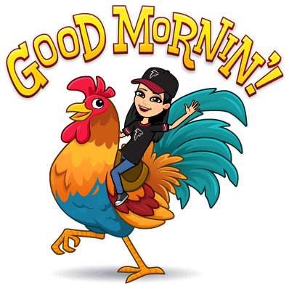
Time of Day Greetings
zǎo shàng hǎo (早上好) = good morning
xià wǔ hǎo (下午好) = good afternoon
wǎn shàng hǎo (晚上好) = good evening
wǎn ān (晚安) = good night
wǎn (晚) = late
ān (安) = peace

Slide 12
Let’s Practice
Hello
How are you?
What is your name?
I’m called…
My name is…
Thanks
Thank you
You’re welcome
I’m sorry/Excuse me
Goodbye
11. Good morning
12. Good afternoon
13. Good evening
14. Good night

