Slide 1
Describing Others/Appearances
By:高老师

Slide 2
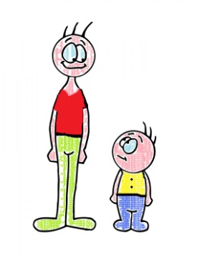
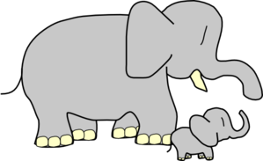
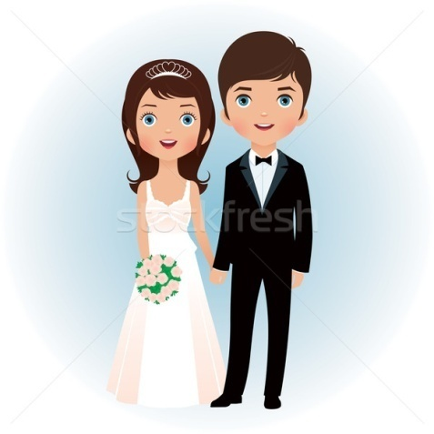
Common adjectives that you’ll often hear/use to describe someone
tall (高 – gāo)
short (height) (矮 – ǎi)
small (小 – xiǎo)
big (大 – dà)
beautiful (漂亮 – piào liàng)
handsome (帅 – shuài)
good looking (好看 – hǎo kàn)
cute (可爱 – kě ài)

Slide 3
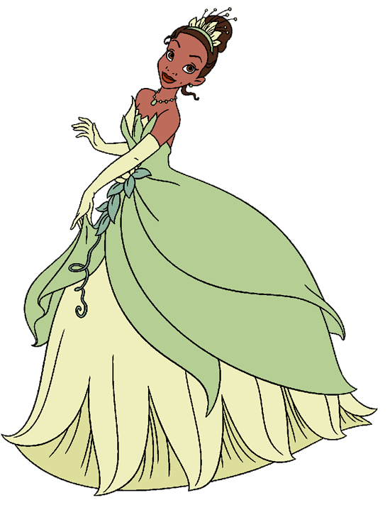
For all of these words, you just add them after “he/she.”
In Chinese, we do not use the word “是 (shì) – is/are/am” when an adjective is describing a noun.
In English, we may say “He is tall.”
In Chinese, we just say, “He tall.”
Therefore,
Tā shì gāo.
Tā gāo.
He is tall. (他高 – tā gāo)
She is small. (她小 – tā xiǎo)
Dad is handsome. (爸爸帅 – Bàba shuài)
Mom is beautiful. (妈妈漂亮 – Māmā piào liang)

Slide 4
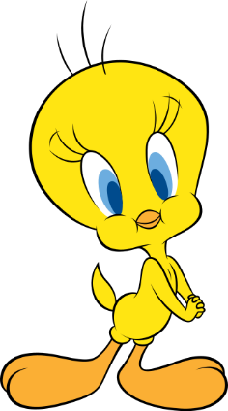
For emphasis, you can add the word for very (很 – hěn):
He is very tall. (他很高 – tā hěn gāo)
She is very small. (她很小 – tā hěn xiǎo)
Dad is very handsome. (爸爸很帅 – Bàba hěn shuài)
Mom is very beautiful. (妈妈很漂亮 – Māmā hěn piào liàng)
Generally speaking, it’s rude to call someone short (at least to their face). Rather than saying “He is short,” you could say “He is not tall” (他不高 – tā bù gāo).

Slide 5
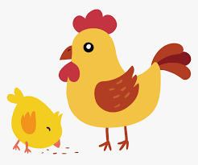
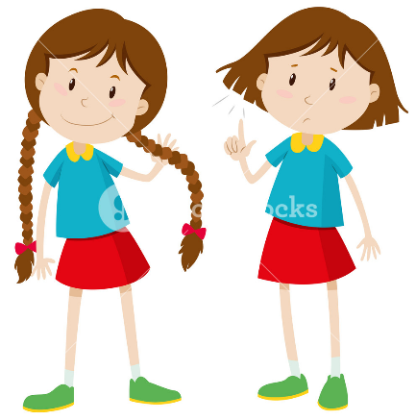
You can also use these adjectives to describe body parts.
small (小 – xiǎo)
big (大 – dà)
long (长– cháng)
short (length) (短 – duǎn)

Slide 6
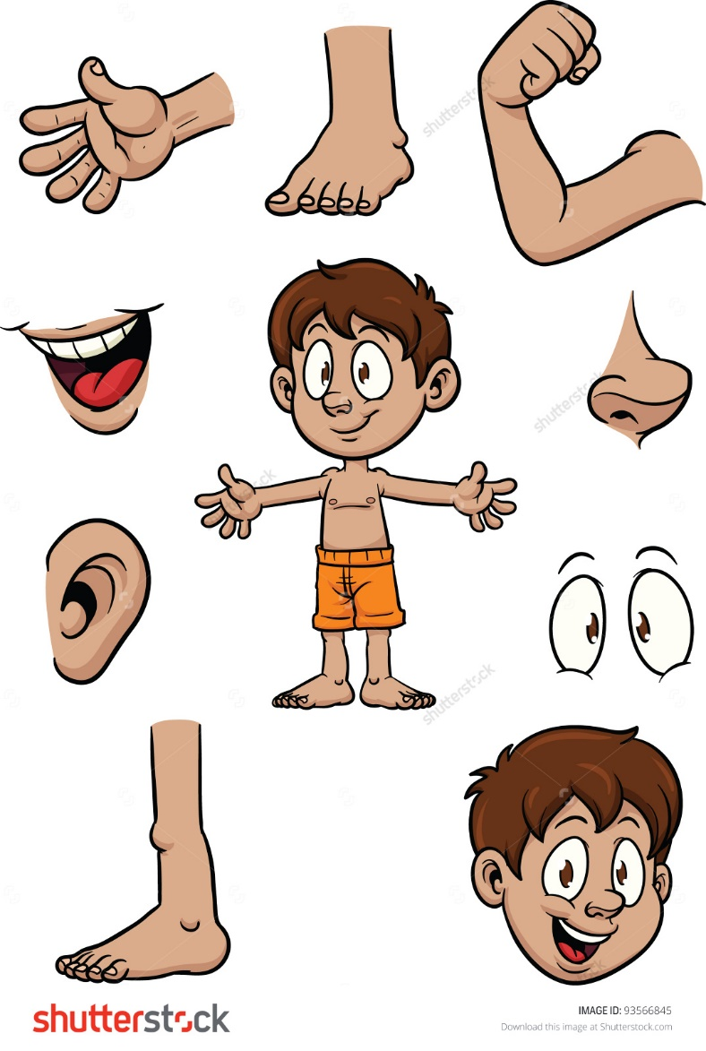
What body parts can you use the words “dà” and “xiǎo” to describe?
Shēn tǐ (body)
Tóu (head)
Jiānbǎng (shoulders)
Jiǎo (foot/feet)
Yǎn jīng (eyes)
Ěr duō (ears)
Kǒu (mouth)
Bǐ zi (nose)
Dù zi (stomach/belly)
Shǒu (hand)

Slide 7
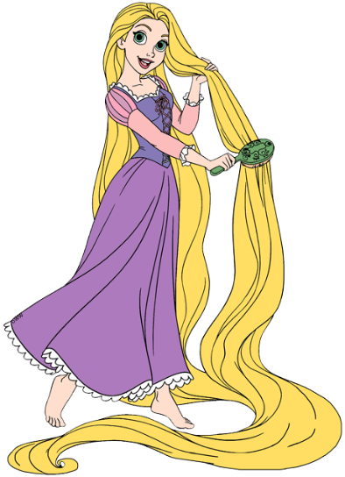
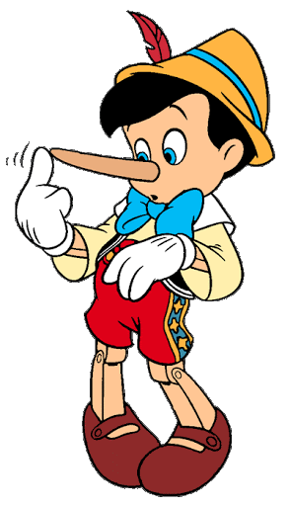
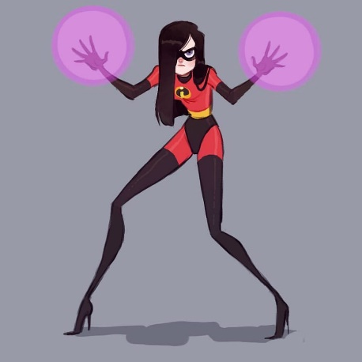
What body parts can you use the words “cháng” and “duǎn” to describe?
Shēn tǐ (body)
Tǒu fǎ (hair)
Ěr duō (ears)
Bǐ zi (nose)
Tǔi (leg)
Jiǎo zhǐ (toes)
Bó zi (neck)
Shǒu bì (arms)
Shǒu zhǐ (fingers)

Slide 8
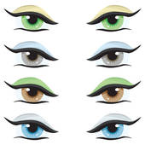
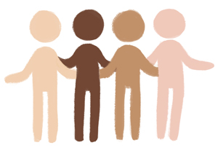
Eye & Skin Color
Next up are some useful words for describing eyes (眼睛 – yǎn jīng) and skin (皮肤 – pí fū):
Yǎn jīng (Eyes)
blue (蓝色的 – lán sè de)
light blue (浅蓝色的 – qiǎn lán sè de)
brown (棕色的 – zōng sè de)
green (绿色的 – lǜ sè de)
Pí fū (Skin)
dark skin (深色的皮肤 – shēn sè de pí fū)
fair skin (白嫩的皮肤 – bái nèn de pí fū)

Slide 9
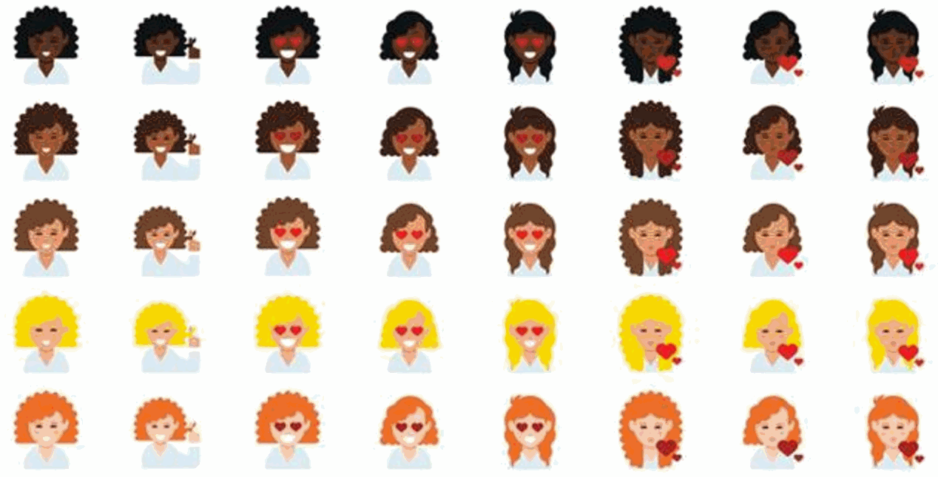
Hair
Now let’s learn how to describe someone’s hair (头发 – tóu fǎ). Here are some useful words
Length/Style
long (长 – cháng)
short (短 – duǎn)
straight (直 – zhí)
curly (卷 – juǎn)
wavy (卷曲 – juǎn qū)
Colors
dark/black (黑色的 – hēi sè de)
brown (棕色的 – zōng sè de)
blonde (金黄色的 – jīn huáng sè de)
red (红色的 – hóng sè de)
gray (灰色的 – huī sè de)

Slide 10
To have/has – yǒu (有)
He has - 他有 (Tā yǒu)
She does not have - 她没有
(Tā méiyǒu)
*NOTE*: It is not 不有 (bù yǒu)

Slide 11
的 (de) – ’s shows possession, belonging
His - Tā de (他的)
Hers – Tā de (她的)
My – Wǒ de (我的)
Yours - Nǐ de (你的)
Theirs – Tā mén de (他们的)

Slide 12
There are two different structures you can use to describe someone’s features–
“He has ___ hair.”
Tā yǒu ___ tóufǎ.
“His hair is ___.”
Tā de tóufǎ ___.
She has straight hair. – Tā yǒu zhí tóu fǎ. (她有直头发.)
Her hair is straight. – Tā de tóu fǎ zhí. (她的头发直.)
You have blue eyes. - Nǐ yǒu lán sè (de) yǎnjīng. (你有蓝眼睛.)
Your eyes are blue. - Nǐ de yǎnjīng lán sè (de). (你的眼睛蓝色.)

Slide 13
Let’s Practice Using “Has” (yǒu - 有)
She has blue eyes. (她有蓝色的眼睛.)
Tā yǒu lán sè (de) yǎnjīng.
He has brown eyes. (他有棕色的眼睛.)
Tā yǒu zōng sè (de) yǎnjīng.
Ellen has fair skin. (Ellen有白嫩的皮肤.)
Ellen yǒu bái nèn (de) pífū.
Kevin has dark skin. (Kevin有深色的皮肤.)
Kevin yǒu shēn sè (de) pífū.

Slide 14
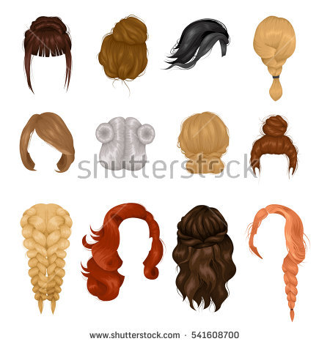
Let’s Practice Using: ’s, Possessive, Belonging de –的
Her hair is short (她的头发短.)
Tā de tóufǎ duǎn.
Billie’s hair is straight. (Billie的头发直.)
Billie de tóufǎ zhí.
His hair is very long. (他的头发很长.)
Tā de tóufǎ hěn cháng.
Shakira’s hair is very curly. (他的头发很卷.)
Shakira de tóufǎ hěn juǎn.

Slide 15
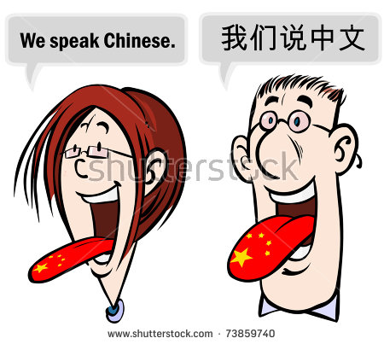
Mixed Practice!
She is tall. (gāo - 高)
He is not tall. (bù gāo - 不高)
She is very small. (xiǎo - 小)
Mom has very blue eyes. (lán sè - 蓝色)
He has dark skin. (shēn sè -深色)
She has long hair. (cháng - 长)
Her hair is very short. (duǎn - 短)
His hair is not straight. (zhí - 直)
The Rock does not have hair.
Dad does not have a small nose.

