Slide 1
About Me 关于我 By: Mrs. Roquemore (高老师)
Guānyú wǒ (关于我)

Slide 2
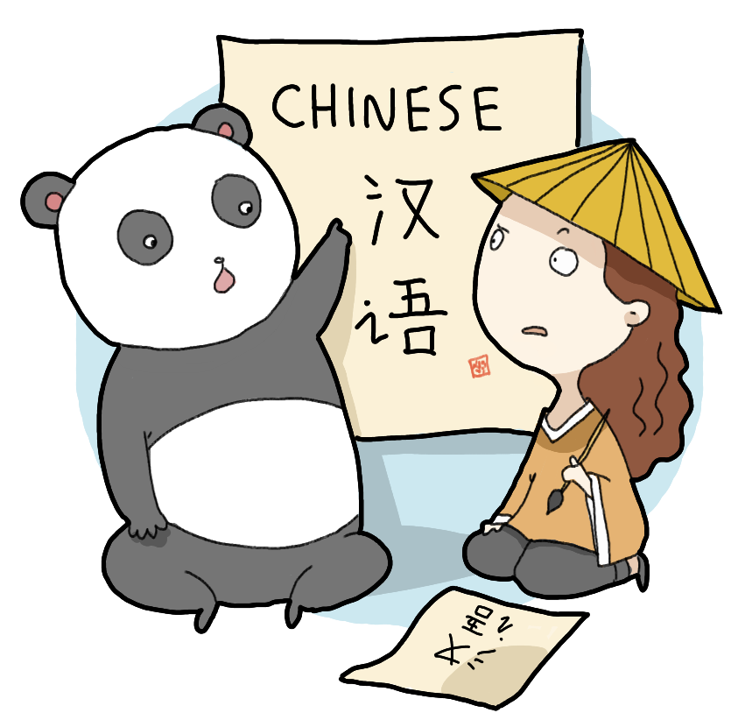
Today’s Lesson
Review Pinyin: We will do more Pinyin and four tone exercises by learning the names of different countries and cities/places.
We will learn to ask people questions and how to answer.
We will learn how to describe ourselves to other people.

Slide 3
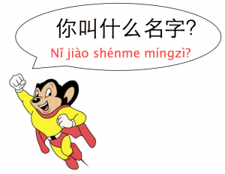
What’s Your Name?
Q: Nǐ jiào shénme míngzì?
(You call what name?)
A: Wǒ jiào _____________.
(I call _____)
A: Wǒ de míngzì shì ______________.
(My name is ____)
Q: Nǐ xìng shénme?
(You last name what?)
A: Wǒ xìng _____________.
(I last name _______)

Slide 4
Where Do You Live?
Q: Nǐ zhù zài nǎlǐ?
(You live in/at/on where?)
A: Wǒ zhù zài Yàtèlándà (Atlanta).
(I live in/at/on Atlanta.)

Slide 5
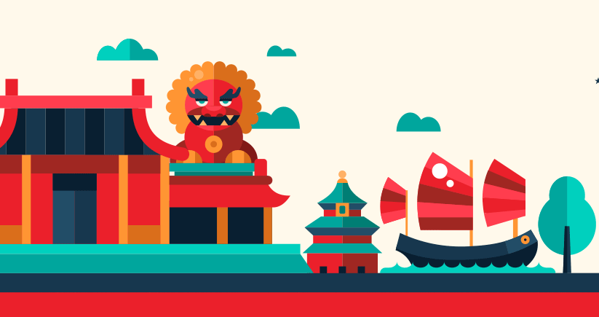
Where Are You From?
Q: Nǐ cóng nǎlǐ lái? (You from where come?)
A: Wǒ cóng _____ lái.
(I from ______ come.)
Q: Nǐ shì nǎlǐ rén?
(You am/is/are where person?)
A: Wǒ shì _____ rén.
(I am/is/are ____ person.)
← Usually used for a foreigner (someone not from the same country as you)

Slide 6
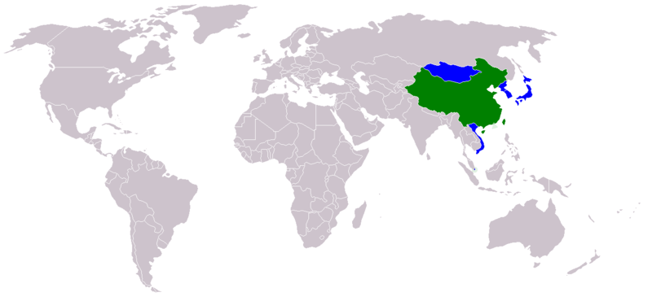
Zhōngguó
中国
Jiā ná dà
加拿大
Měiguó
美国
Hán guó
韩国
Yīngguó
英国
Rìběn
日本
Táiwān
台湾
Mòxīgē墨西哥
Yìdàlì
意大利

Slide 7
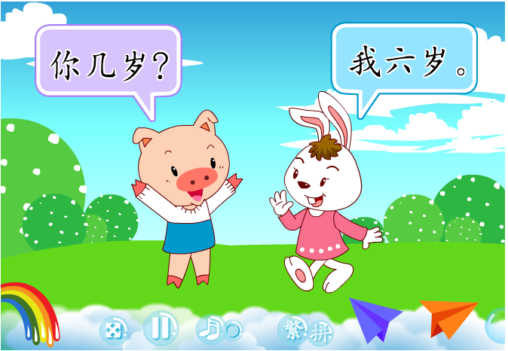
How Old Are You?
Q: Nǐ jǐ suì? or Nǐ duō dà?
(You how many years old?) (You many big?)
A: Wǒ _____ suì.
(I _____ years old.)

Slide 8
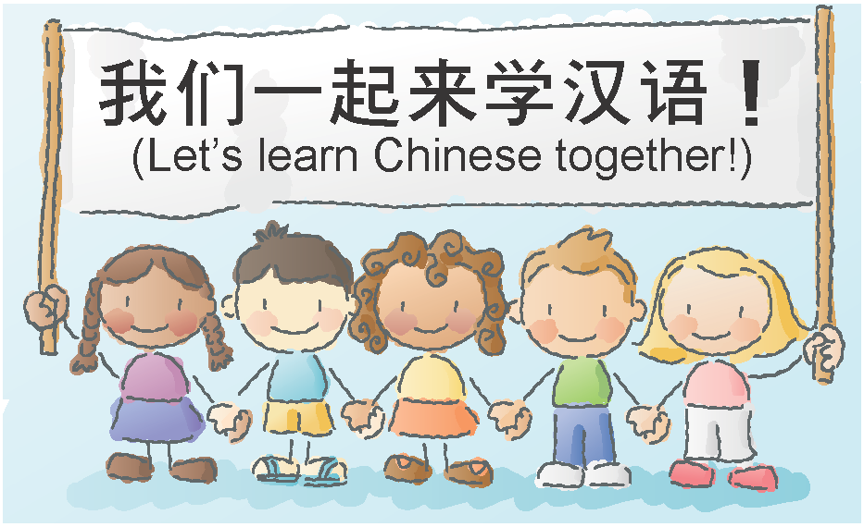
What Grade Are You In?
Q: Nǐ shàng jǐ niánjí?
(You on how many grade?)
A: Wǒ shàng 6 niánjí.
(I on six grade.)

Slide 9
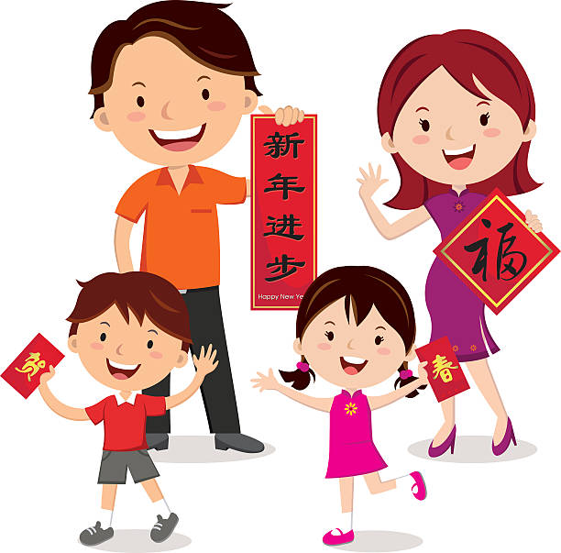
How Many People in Your Family?
Q: Nǐ de jiā yǒu jǐ kǒu rén?
(Your house has how many mouth [counter] people?)
A: Wǒ de jiā yǒu ____ kǒu rén.
(My family has ____ mouth people.)

Slide 10
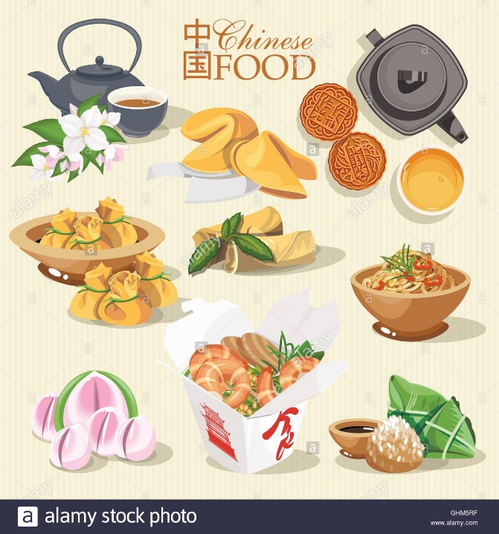
Your Likes (xǐhuān) Dislikes (bù xǐhuān)
I like = Wǒ xǐhuān…
I don’t like = Wǒ bù xǐhuān…
eat = chī (吃)
drink = hē (喝)
listen = tīng (听)
watch/look/read = kàn (看)
play = wán (玩)
**Note: Only used for games, not sports

Slide 11
How to Ask About Your Likes?
Q: What do you like to _______?
Nǐ xǐhuān _______ shén me?
(You like ______ [insert verb] what?)
A: I like to ______ (verb) _______ (noun).
Wǒ xǐhuān _____ (verb) _____ (noun).

