Slide 1
Why English is Hard to Learn & Reasons Why Chinese is Easier
By: Mrs. Roquemore (高老师)

Slide 2
Why English is Hard to Learn

Slide 3
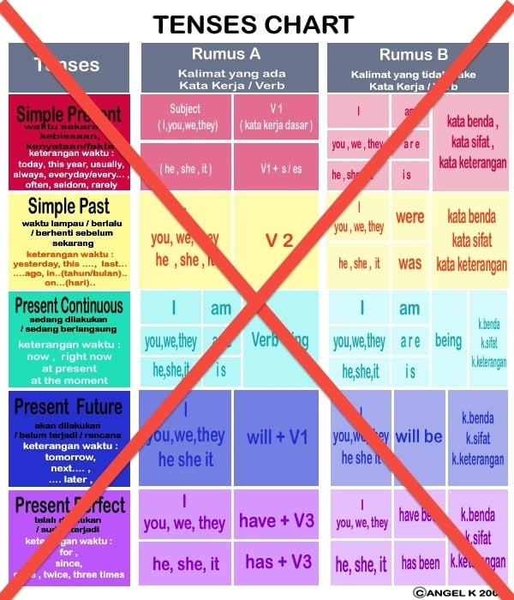
Reasons Why Chinese is Easier
Mandarin does not care about tenses.
English verb “is”
I am
He is
They are
We are
Chinese verb “is” (是 shì)
Wǒ shì (我是)
Tā shì (他是)
Tā men shì (他们是)
Wǒ men shì (我们是)

Slide 4
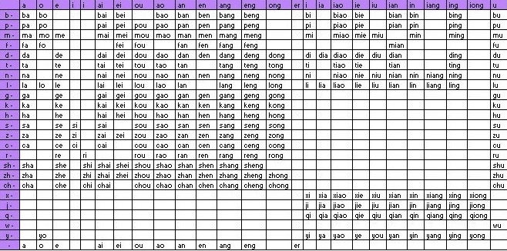
Reasons Why Chinese is Easier
2. Mandarin does not have that many combinations of sounds.
All the sounds that you see in the image are all the sounds in the language.

Slide 5
Reasons Why Chinese is Easier
3. Most words in Mandarin only have one or two syllables.
And each character is only 1 syllable.

Slide 6
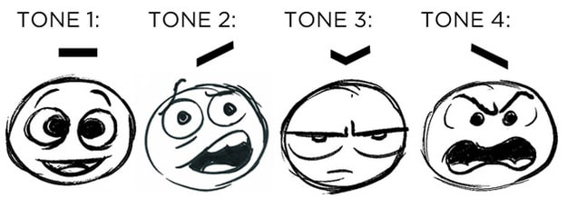
Reasons Why Chinese is Easier
4. Even though tones in Mandarin are very important, you can still usually figure out what people are saying (through context) even if their tones aren’t correct.

Slide 7
While these languages are fighting with each other…

Slide 8
Reasons Why Chinese is Easier
5. Articles (words like “the”, “an”, and “a”) don’t even exist in Mandarin.
Literally, they don’t exist.
And therefore, do not have “genders”.

Slide 9
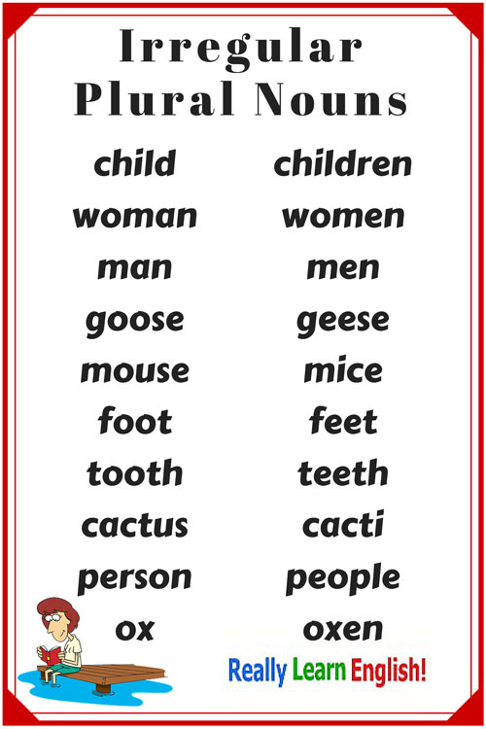
Reasons Why Chinese is Easier
6. Nouns in Mandarin don’t have plurals.
Which means you can avoid all of this.

Slide 10
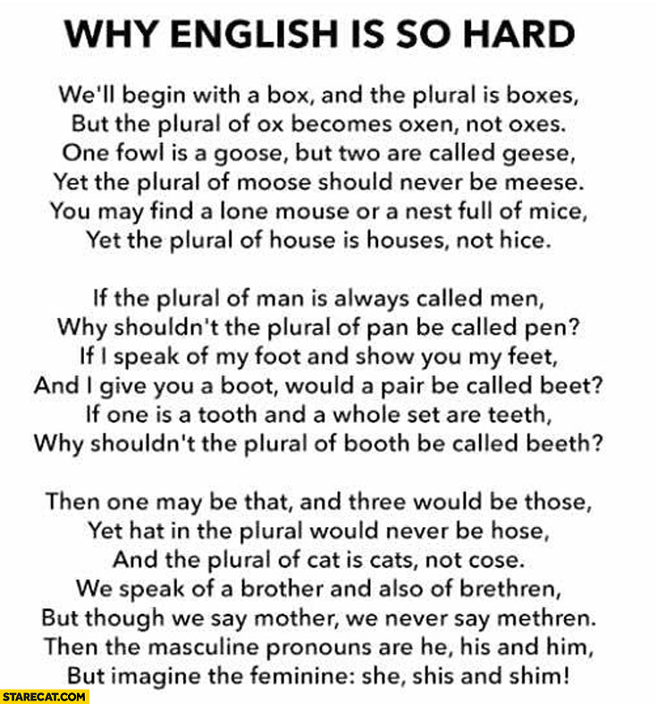
Why English is Hard to Learn

Slide 11
Reasons Why Chinese is Easier
7. Vocabulary combinations make more sense.

Slide 12
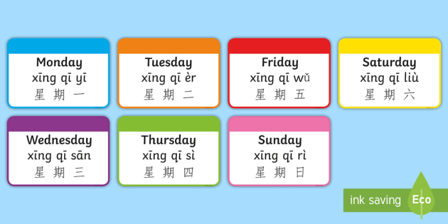
Reasons Why Chinese is Easier
8. Numbers are used waaaaayy more effectively and efficiently.

Slide 13
Reasons Why Chinese is Easier
9. Some Chinese characters actually look like the things they are describing.
(So it’s almost like reading a picture book.)

Slide 14
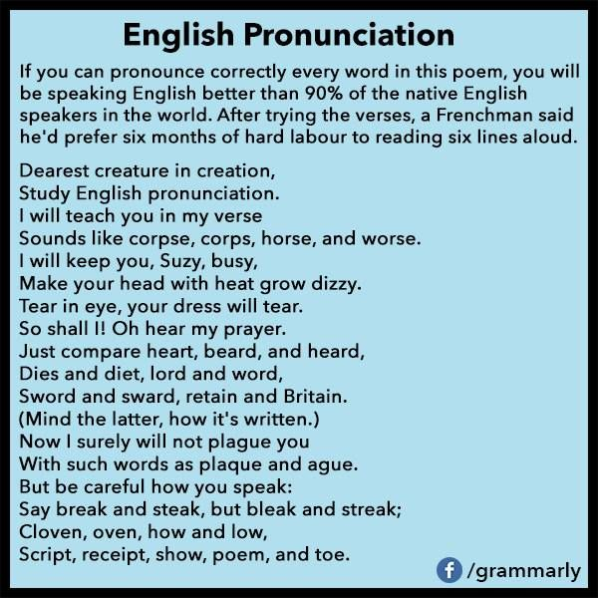
Why English is Hard to Learn

Slide 15
Riddle Me This…
Why do we drive on a parkway, and park on a driveway?

