Slide 1
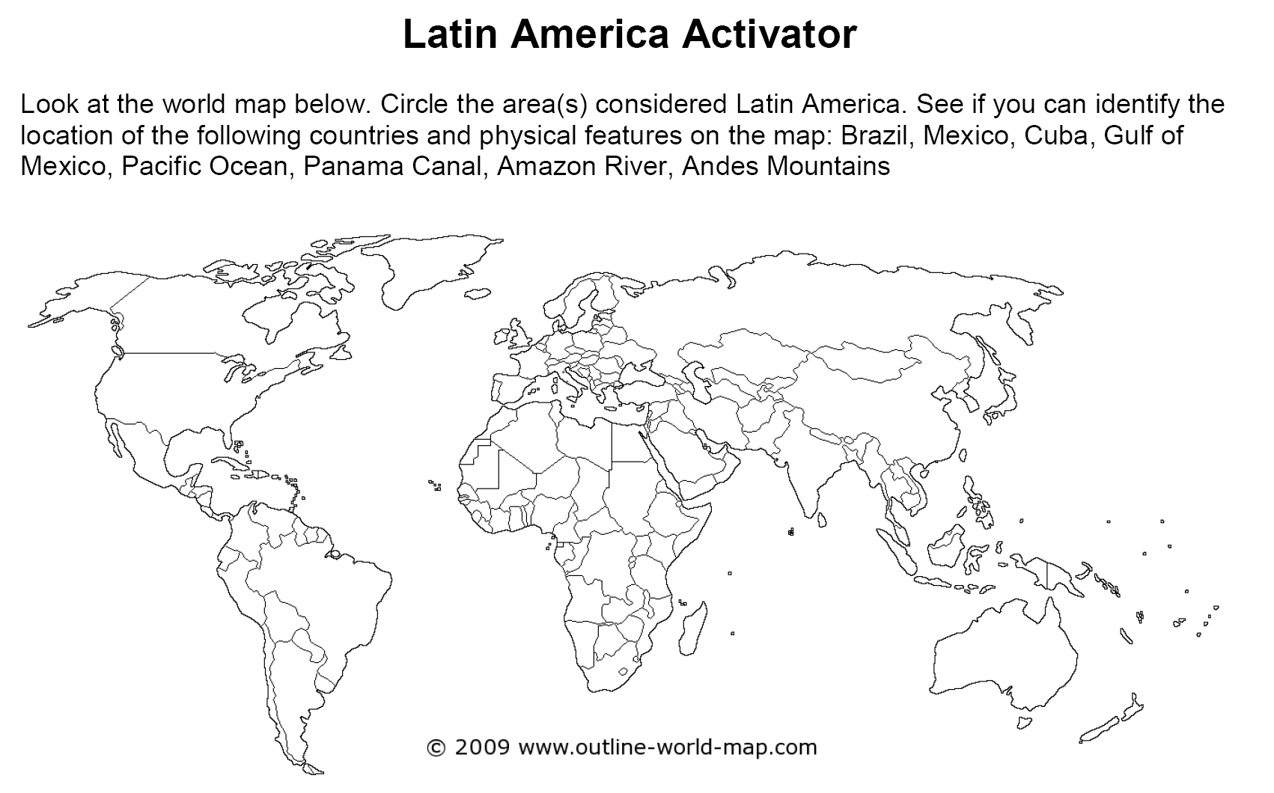

Slide 2
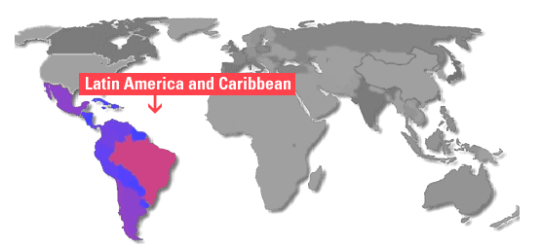
Essential Question: Where are the major physical features and nations of Latin America located?

Slide 3
Standards:
SS6G1a. Locate on a world and regional political-physical map: Amazon River, Caribbean Sea, Gulf of Mexico, Pacific Ocean, Panama Canal, Andes Mountains, Sierra Madre Mountains, and Atacama Desert.
SS6G1b. Locate on a world and regional political-physical map the countries of Bolivia, Brazil, Colombia, Cuba, Haiti, Mexico, Panama, and Venezuela

Slide 4
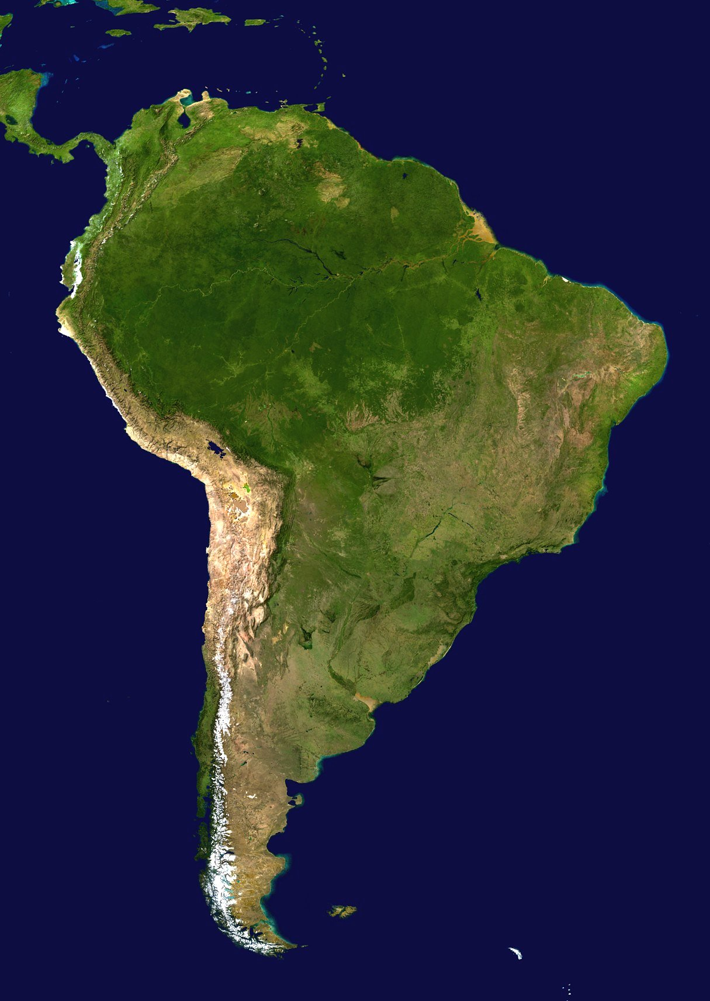
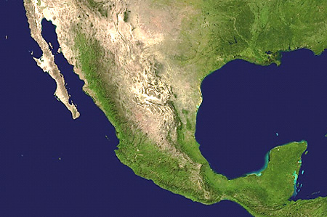
Latin America

Slide 5
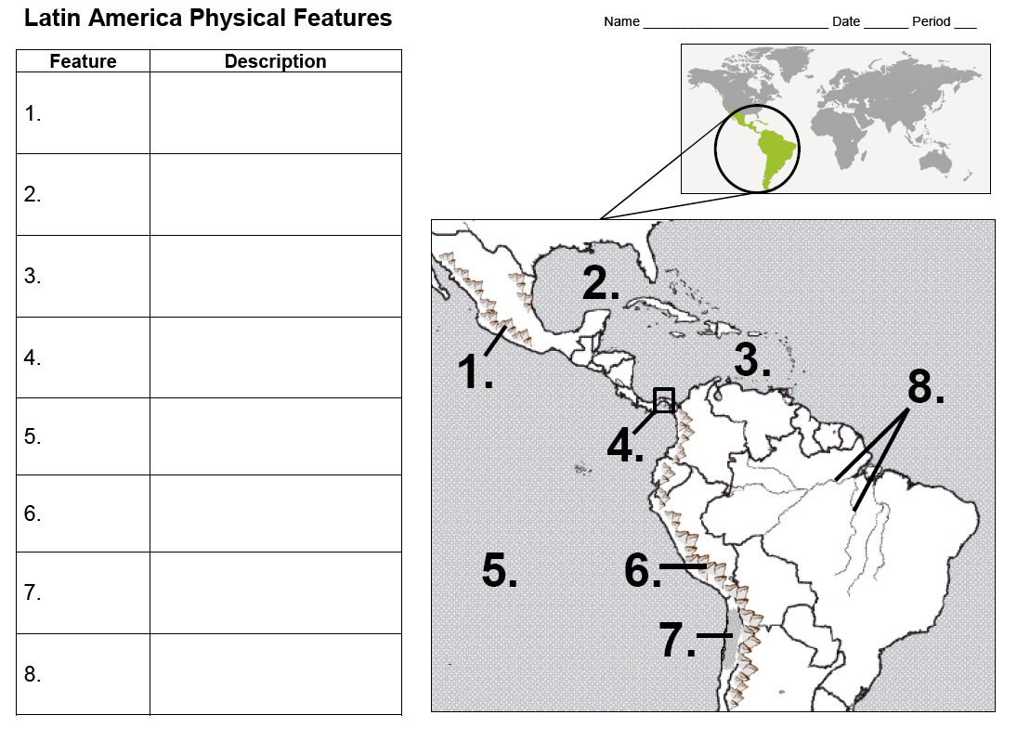
Use the Latin America Physical Features Map

Slide 6
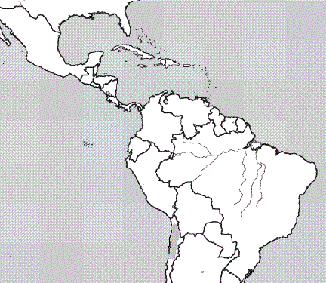
Sierra Madre Mountains
1.

Slide 7
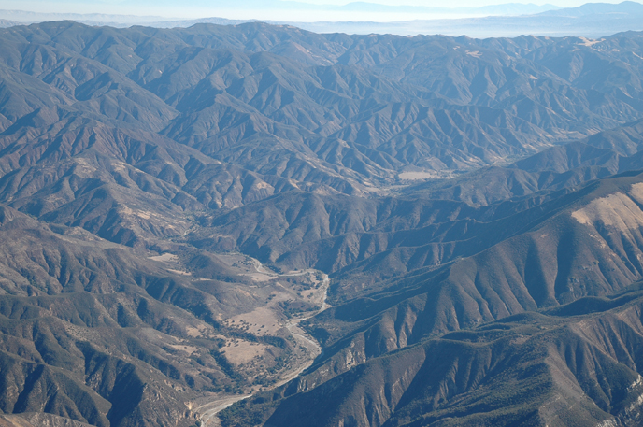
Sierra Madre Mountains: Main mountain range in Mexico with three major chains

Slide 8
Gulf of Mexico
2.

Slide 9
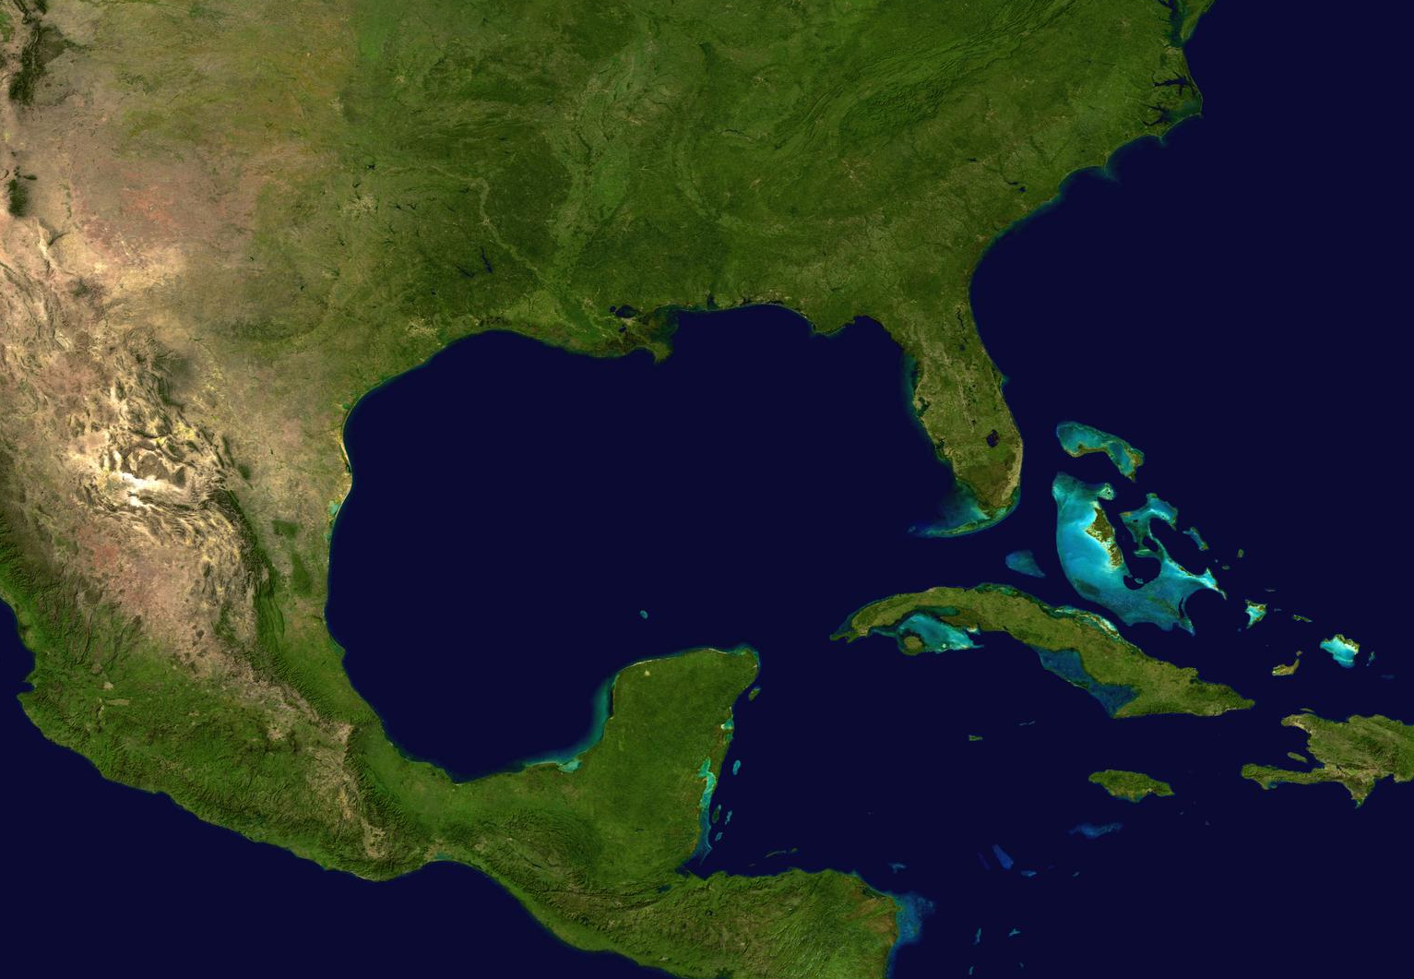
Gulf of Mexico: Arm of Atlantic Ocean; Mississippi River and Rio Grande are two major rivers that flow into the Gulf of Mexico

Slide 10
Caribbean Sea
3.

Slide 11
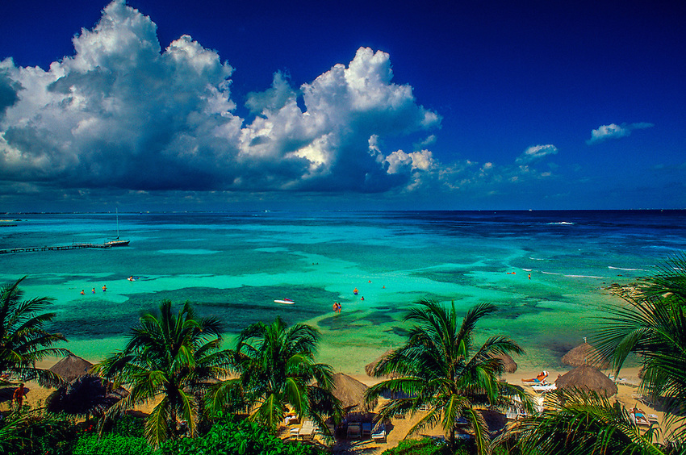
Caribbean Sea: Arm of the Atlantic Ocean; popular tourist attraction due to beautiful beaches and mild tropical climate

Slide 12
Panama Canal
4.

Slide 13
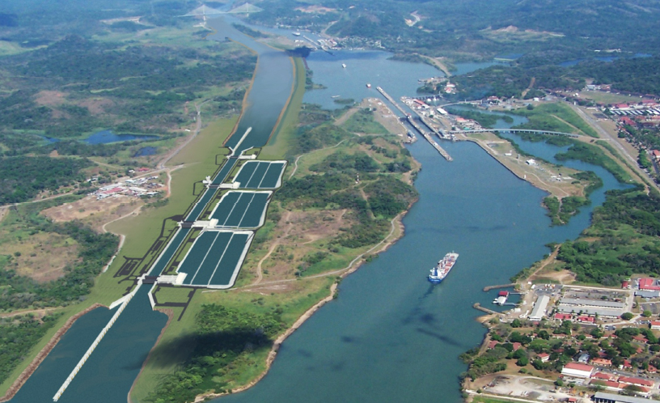
Panama Canal: Canal built to allow ships to travel easily between the Atlantic and Pacific Oceans.

Slide 14
Pacific Ocean
5.

Slide 15
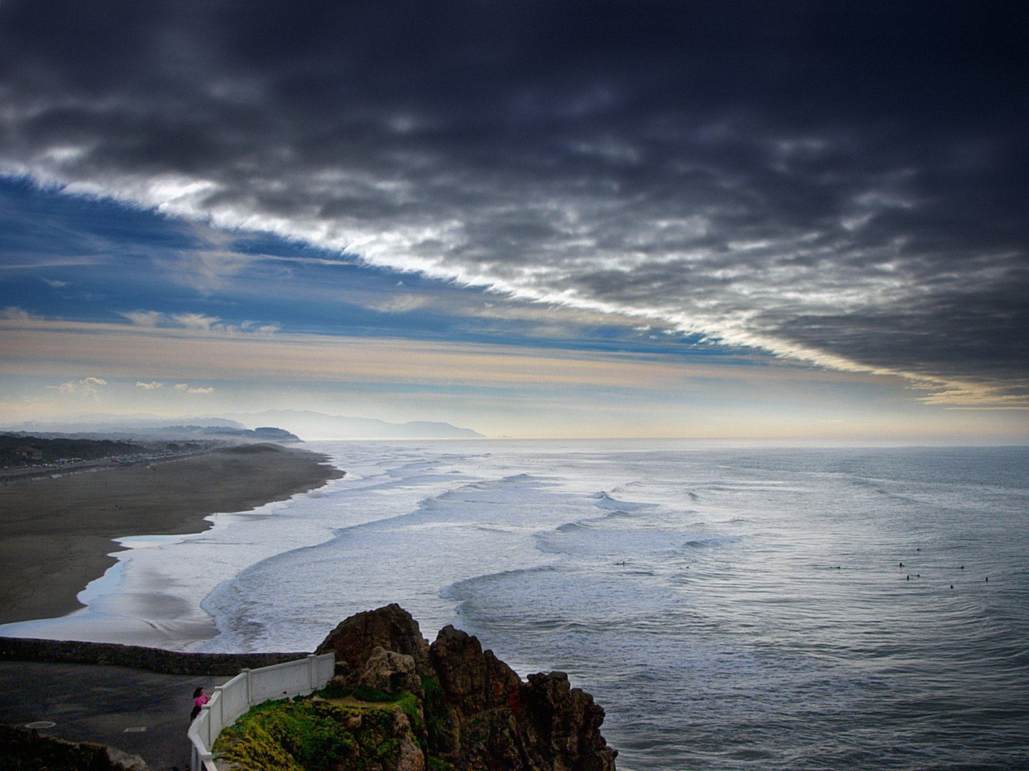
Pacific Ocean: Largest and deepest ocean; larger than the total land area of the world

Slide 16
Andes Mountains
6.

Slide 17
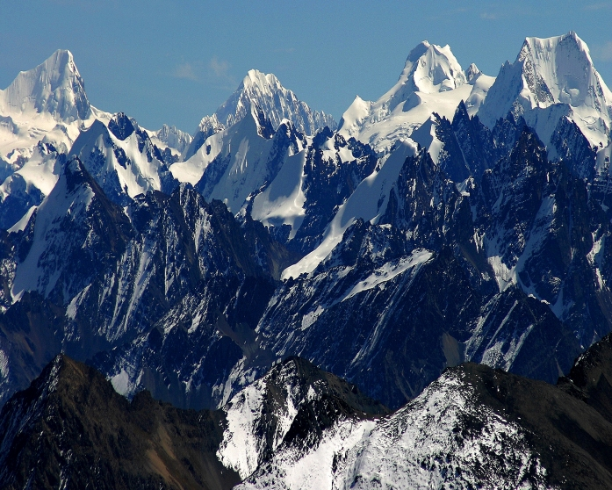
Andes Mountains: Chain along the western edge of South America that is the longest continuous mountain range in the world

Slide 18
Atacama Desert
7.

Slide 19
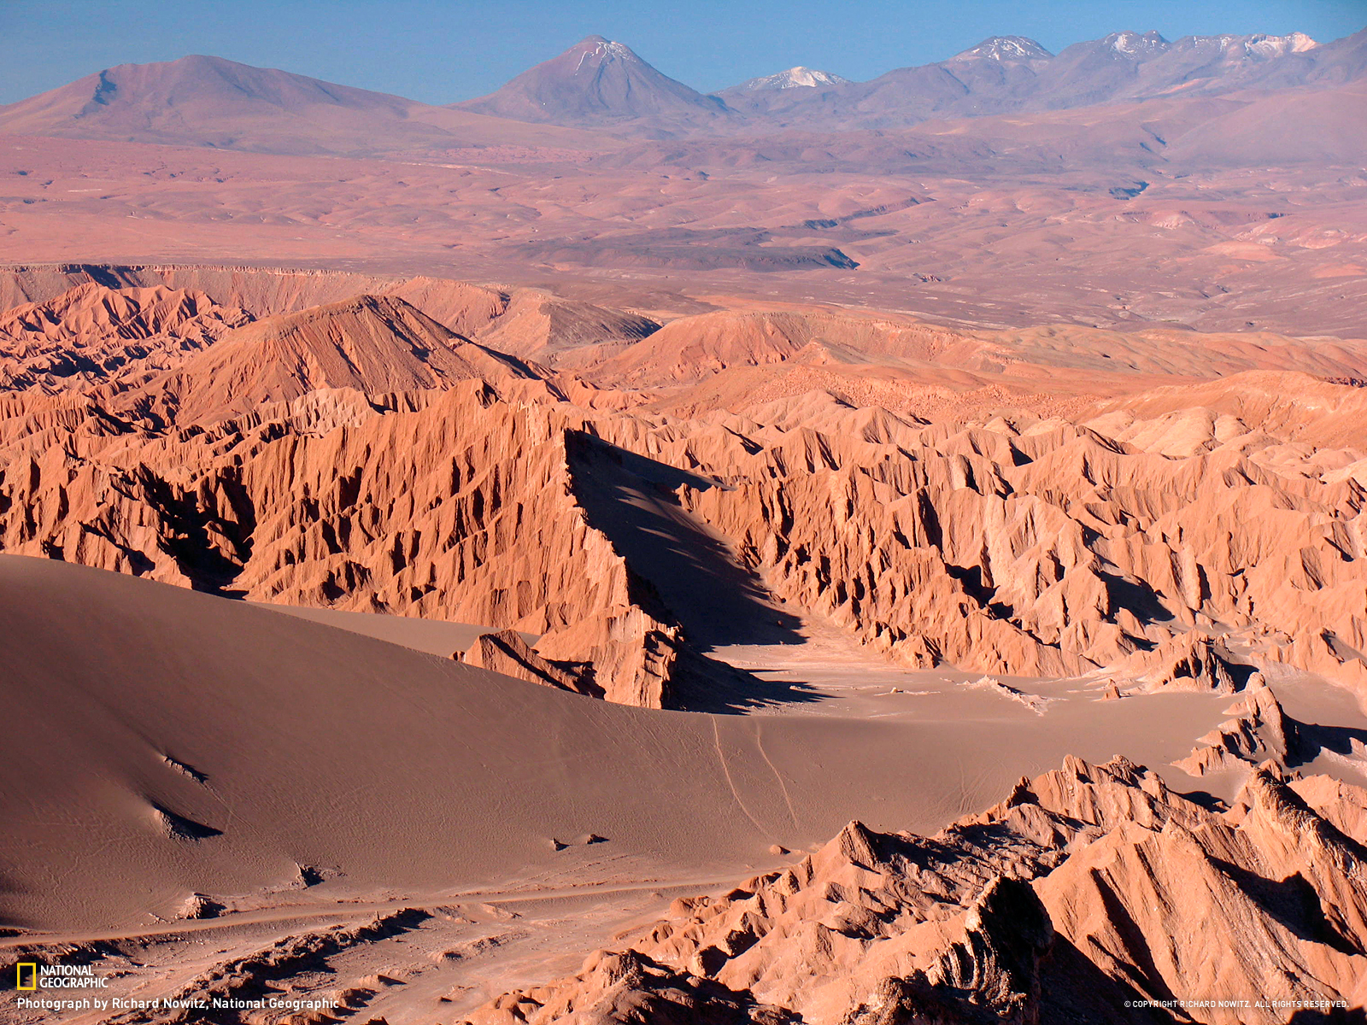
Atacama Desert: Driest place on earth; high elevation along coast of Chile; average temperature is actually chilly; parts have never had rain

Slide 20
Amazon River
8.

Slide 21
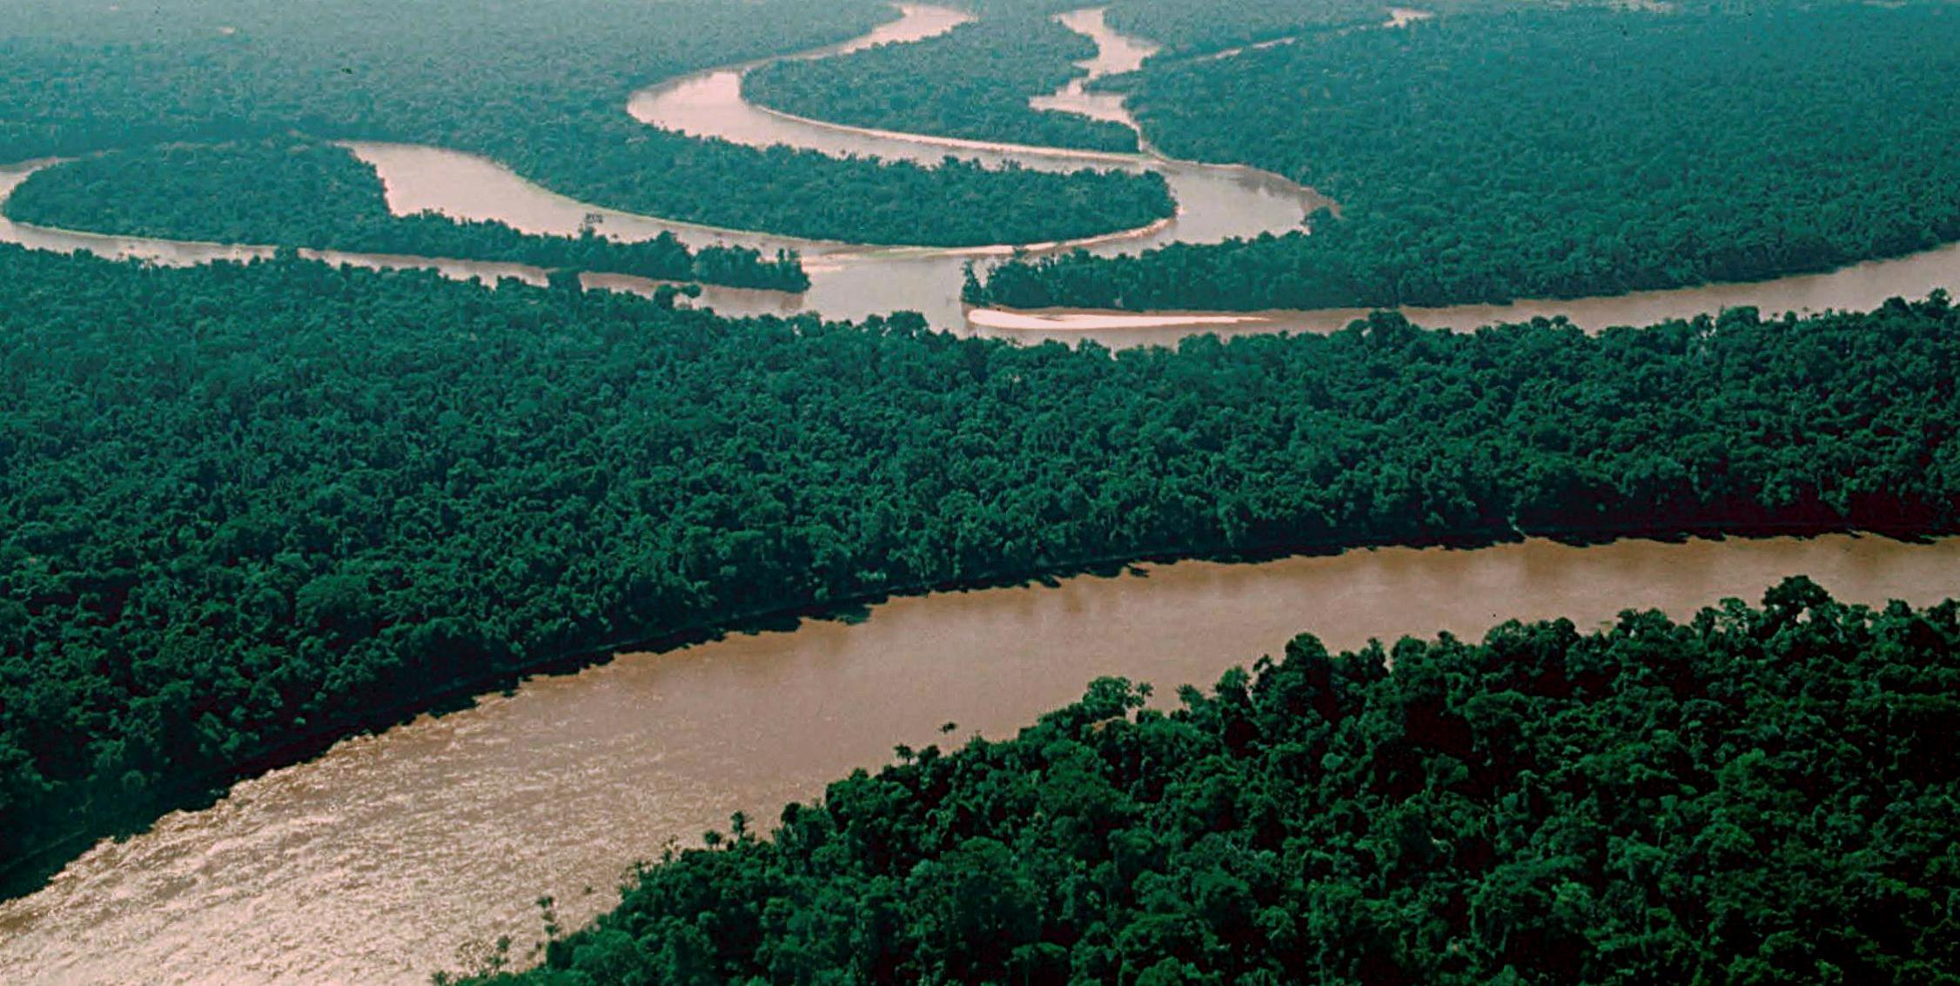
Amazon River: Second longest river in the world; flows mostly through Brazil; carries the greatest volume of water of any river

Slide 22
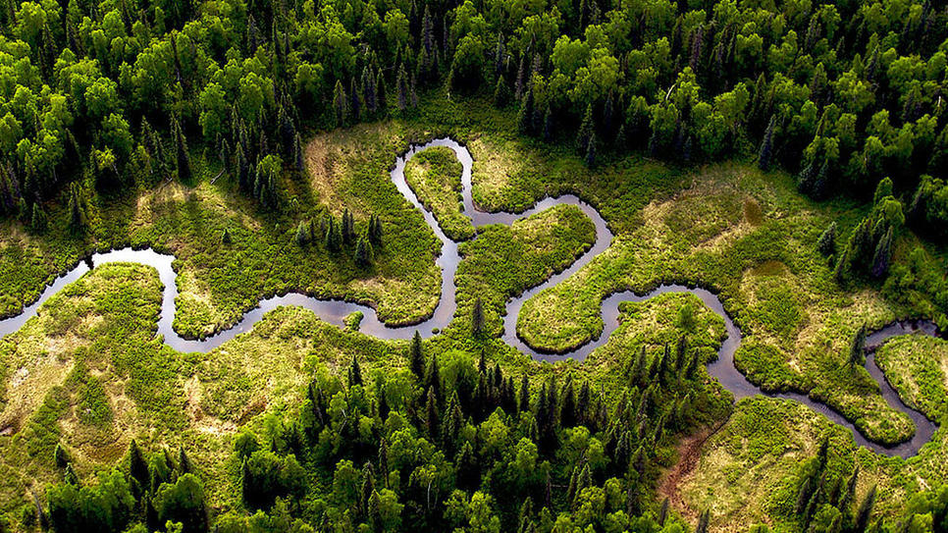
Amazon River

Slide 23
Formative Assessment

Slide 24
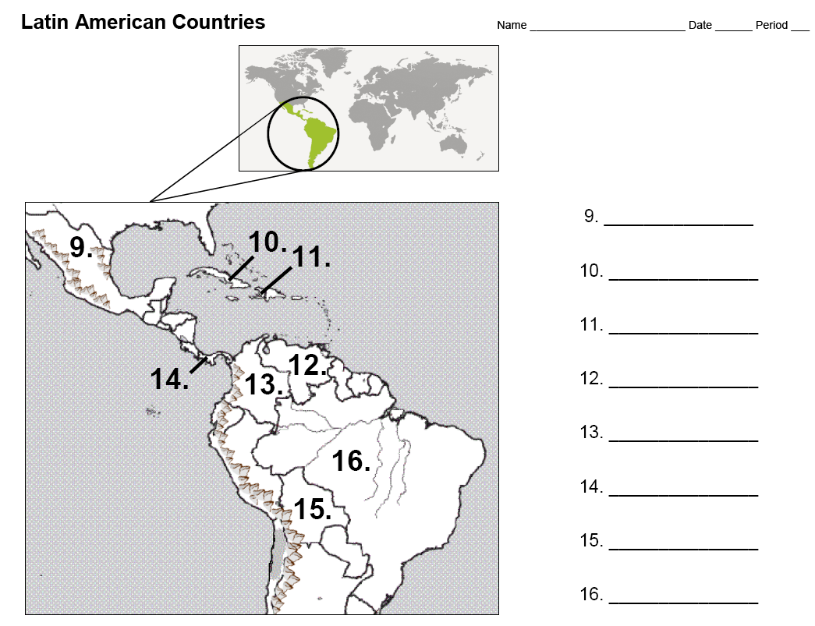
Use the Latin American Countries Map

Slide 25
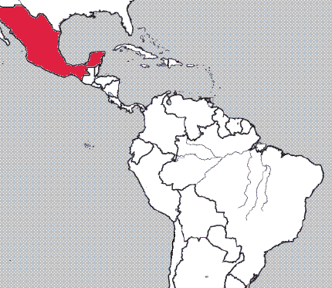
Mexico
9.

Slide 26
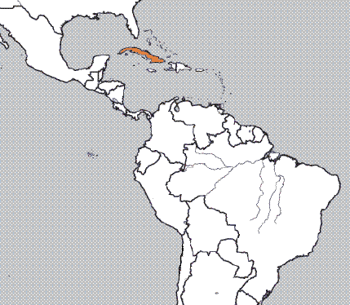
Cuba
10.

Slide 27
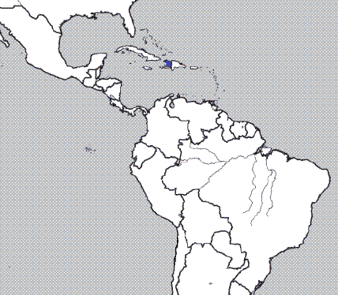
Haiti
11.

Slide 28
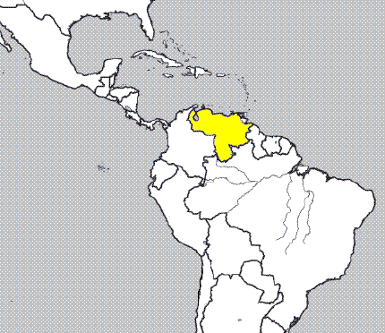
Venezuela
12.

Slide 29
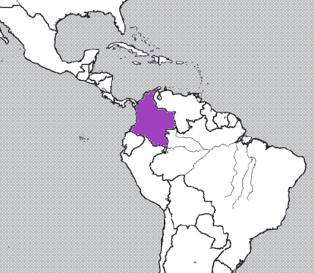
Colombia
13.

Slide 30
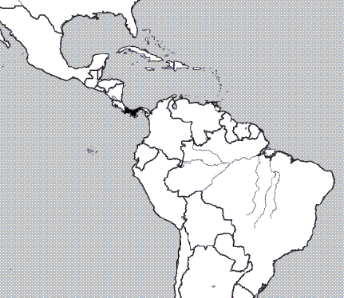
Panama
14.

Slide 31
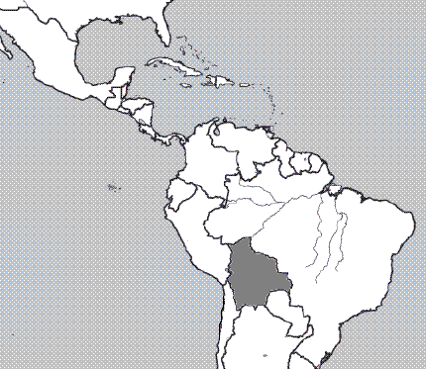
Bolivia
15.

Slide 32
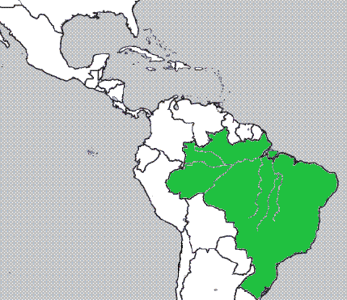
Brazil
16.

Slide 33
Create a Mnemonic Device to help remember the countries of Latin America
Notes:
Have students work individually or with a partner to create a mnemonic device to remember the countries of Latin America. Students can write their mnemonic device on the bottom of their map sheet. Share several devices with the class.

Slide 34
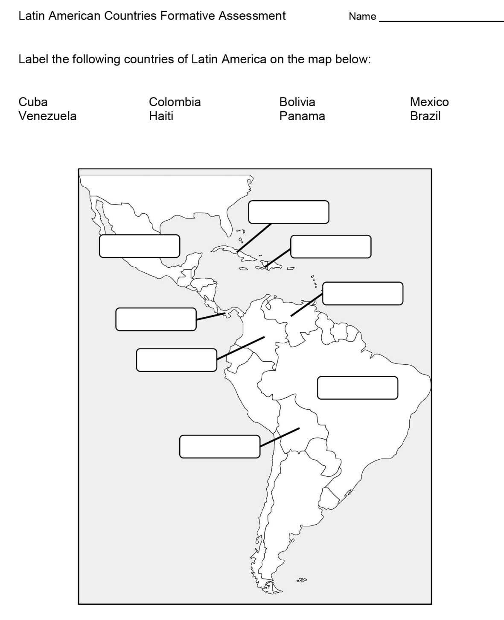
Formative Assessment

Slide 35
Physical and Political Features Review Activities [if needed]
Latin America Physical and Political Features Flashcards
Physical and Political Features Slipcover

Slide 36
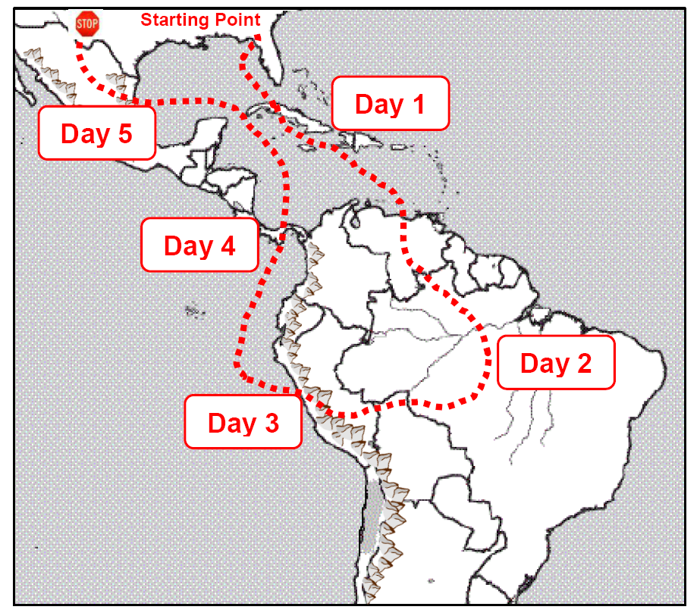
Summarizer
Notes:
There are two options for the summarizer. The one shown on the slide is the lower level version. Another version is higher level because students have to select a starting point, a direction, and determine the physical features and countries seen in each day. Additionally, a word bank is not included for the physical features and countries.

